Slide 1
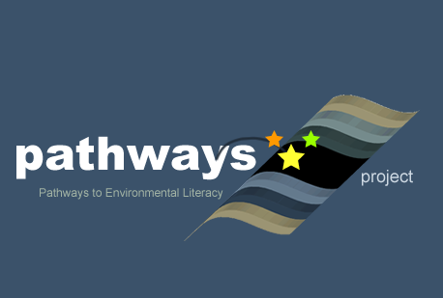
Learning Progressions Immersion Activity
Power point presented to teachers during professional development to help teachers learn about learning progressions and student thinking
, Alan Berkowitz¹, Brad Blank², Aubrey Cano³, Bess Caplan¹, Beth Covitt⁴, Katherine Emery³, Kristin Gunckel⁵, LaTisha Hammond⁶, Bill Hoyt⁷, Nicole LaDue⁸, John Moore², Tamara Newcomer¹, Tom Noel², Lisa Pitot², Jen Schuttlefield⁹, Sara Syswerda⁸, Dave Swartz², Ray Tschillard¹⁰, Andrew Warnock and Ali Whitmer⁶.
Cary Institute¹, Colorado State Univ. ², U.C. Santa Barbara³, Univ. Montana⁴, Univ. of Arizona⁵, Georgetown Univ.⁶, Univ. Northern Colorado ⁷, Michigan State Univ.⁸, Univ. Wisconsin⁹, Poudre Learning Center¹⁰
Culturally relevant ecology, learning progressions and environmental literacy
Long Term Ecological Research Math Science Partnership
2012
Disclaimer: This research is supported by a grant from the National Science Foundation: Targeted Partnership: Culturally relevant ecology, learning progressions and environmental literacy (NSF-0832173). Any opinions, findings, and conclusions or recommendations expressed in this material are those of the author(s) and do not necessarily reflect the views of the National Science Foundation.

Slide 2
Learning Progressions
Water in Socio-ecological Systems
Math Science Partnership (MSP) Culturally Relevant Ecology, Learning Progressions and Environmental Literacy

Slide 3
Overview
Introduction to Learning Progressions
Explore some data for patterns
Develop learning progressions
Compare to the Learning Progression for Water in Socio-Ecological Systems
Notes:
Today we’re going to give a brief overview of environmental science literacy and learning progressions for water in socio-ecological systems.

Slide 4
Learning Progressions
Descriptions of the successively more sophisticated ways of thinking about a topic that can follow one another as children learn about and investigate a topic over a broad span of time. (NRC, 2007)

Slide 5
Helps Us Think About
How students’ ideas change from their initial ideas to more scientific thinking.
What the connections are between students’ experiences and how they are thinking about concepts at different points in their K-12 schooling
How this knowledge can help us rethink curriculum to best help students learn.
Notes:
To support students in becoming environmentally literate citizens, we need to know how students ideas and the connections they see in their experiences change as they move through school.

Slide 6
Learning Progressions
Upper Anchor = Scientific Reasoning
What high school students should know and be able to do
Lower Anchor = Informal Ideas
How children think and
make sense of the world
Notes:
Learning progressions connect how students think about the world to the scientific ideas we would like them to know and be able to use when they finish high school. Learning progressions are different from scope and sequences because they start with the empirical evidence about how students see the world and trace their learning from there.
First we need to define the upper & lower anchors.
Upper anchor – what we want HS students to know and be able to do
Based on:
Cutting-edge science (too complex to be used as is)
Societal needs
What’s achievable (from educational research)
Lower anchor – how children think and make sense of the world
Based on:
Empirical research on current student understanding
Based on educational research guided by upper anchor (e.g., research reported in this talk)
Then we need to figure out reasonable steps between the upper and lower anchors that are responsive to children’s ways of thinking and reflect gradually more sophisticated ways of thinking.

Slide 7
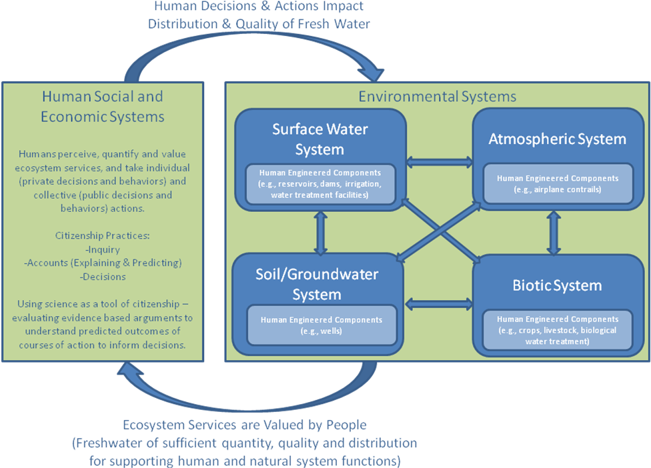
The Loop Diagram
Notes:
Here is how we think about what environmentally literate citizens need to know about water.
There are two boxes here. The right box represents all the systems through which water moves, including human systems. The arrows within the right box represent the processes that move water, such as evaporation or infiltration or precipitation. Environmental systems an important service valued and necessary for life, in this case abundant supplies of high quality fresh water. Human actions and decisions have impacts back on the water moving through environmental systems.
We argue that environmentally literate citizens should have an understanding of the structure of systems that water moves through, the processes that move water and substances through these systems, and the principles that govern the movement of water and substances. Furthermore, citizens can reason about water moving through these systems at all scales from landscapes to atomic-molecular.

Slide 8
Two Foci
Water moving through connected systems
Substances in water moving through connected systems
Mixing
Unmixing
Moving

Slide 9
Developing a Learning Progression
ASSESSMENTS:
Develop/revise interview protocol and written assessment items; Collect data
INTERPRETATION: Analyze data and identify patterns of students’ learning performances
MODEL OF COGNITION: Develop/Revise Learning progression framework

Slide 10
Exploring Student Data
For each item (Soccer Game, River Maps, Fertilizer)
Rank the items from least sophisticated (1 ) to most sophisticated (10).
Group the ranked items into 3-5 groups based on common characteristics.
Describe the characteristics of each group for each item

Slide 11
Synthesize Levels
Look across the groupings for each item.
Synthesize into a master learning progression (lowest level on the bottom) by describing common features across the groupings for all three items. This is your draft learning progression.
Compare your learning progression with another group.
What is similar?
What is different?

Slide 12
Upper Anchor: Scientific Model-Based Reasoning
General
Phenomena are parts of connected, dynamic systems that operate at multiple scales according to scientific principles
Models are abstractions of systems that focus on key features to explain and predict scientific phenomena
Water
Water and substances move through connected systems
Pathways are constrained by
Laws (e.g., conservation of matter)
Forces (e.g., gravity, pressure)
Constraining variables (e.g., permeability, topography, solubility)

Slide 13
Lower Anchor: Force Dynamic Reasoning
Actors with purposes/needs confront antagonists (hindering forces)
Events determined through interplay of countervailing powers
Humans have most powers/abilities; non-living entities can be actors too
Example: Tree’s purpose is to grow. Enablers include sunlight, soil, and water. Antagonists include drought and logging.

Slide 14
Levels of Achievement
Levels of Achievement | Progress Variables
 | Moving Water | Substances in Water
4: Qualitative model-based accounts | Traces water through connected systems (multiple pathways/scales). Identifies driving forces and constraining variables | Identifies and traces substances mixing, moving, and unmixing with water (multiple pathways/scales). Identifies chemical nature of substances in water
3: “School science” narratives | Puts events in order Does not use driving forces or constraining variables Descriptions at macroscopic scale | Identifies types of substances with moderate specificity Distinguishes types of mixtures based on macroscopic properties and interactions
2: Force-dynamic narratives with hidden mechanisms | Recognizes water can move and that there are hidden mechanisms moving water. Uses force-dynamic thinking that invokes actors or enablers. | Recognizes water quality can change. Thinks of water quality in terms of bad stuff mixed with water. Invokes actors or enablers to change water quality.
1: Force-dynamic narratives | Focuses on human-centric actions & concerns Focuses on immediate and visible Does not view water in a location as connected to other water. | Views water quality in terms of types of water (e.g. dirty water). Actors can change water without mechanisms (e.g., using a cleaning machine)
Notes:
Progress along the levels of achievement represents not only addition of concepts, but also a change in how one thinks about the world.
The lower anchor represents force dynamic thinking – Where actors and enablers do things to water to change it or make it move.
The upper anchor represents model-based reasoning. – What we expect students to achieve by high school. Uses principles to reason about where water goes or what is in water.
An important level of achievement in this research is Level 3 – School science narratives. Can tell stories about where water goes, but does not use principles such as gravity or permeability to reason about pathways or what is in the water.

Slide 15
Challenges
Understanding systems and connections among systems at multiple scales
Invisible
Hidden
Human-engineered
Understanding driving forces, mechanisms and constraining variables
Using representations for reasoning at multiple scales

