Slide 1


Let’s get into an argument Citizenship Mini-Unit
Teacher Professional Development Power point Presentation to introduce Citizenship Teaching Experiments
Written by: Beth Covitt (University of Montana) and Cornelia Harris (Cary Institute of Ecosystem Studies)
Culturally relevant ecology, learning progressions and environmental literacy
Long Term Ecological Research Math Science Partnership
April 2012
Disclaimer: This research is supported by a grant from the National Science Foundation: Targeted Partnership: Culturally relevant ecology, learning progressions and environmental literacy (NSF-0832173). Any opinions, findings, and conclusions or recommendations expressed in this material are those of the author(s) and do not necessarily reflect the views of the National Science Foundation.

Slide 2
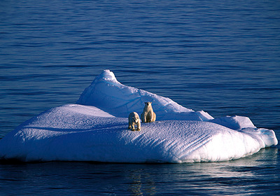

“Let’s Get Into An Argument”
Citizenship Mini-Unit
Using Science In Decision-Making

Slide 3
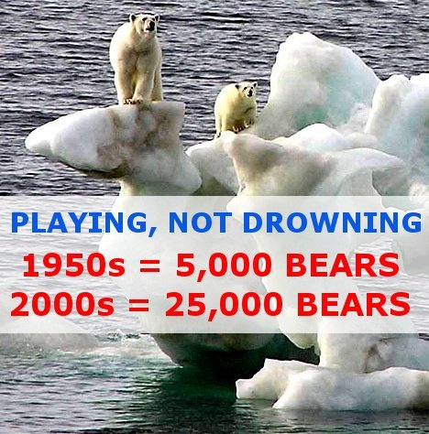
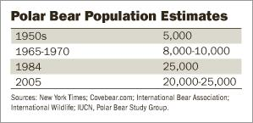
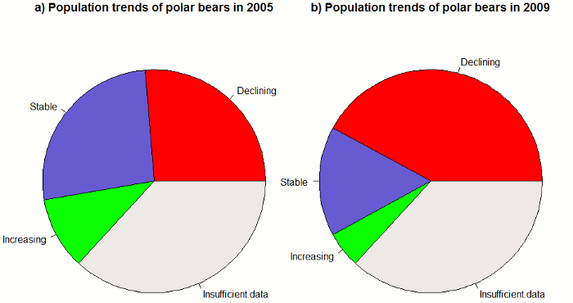
Consider Two Sets of Information
Source 1
Source 2
Data from the World Conservation Union Polar Bear Specialist Group (2010) about 19 separate populations of polar bears.

Slide 4
What is a Scientific Argument and how is it different than arguments people have in everyday life?
Characteristics of
Scientific Arguments
Characteristics of
Everyday Arguments
Notes:
Brainstorm with teachers on slide

Slide 5
Using Science In Decision-Making
Mini Unit Overview
Students are introduced to…
  Scientific arguments (claims, evidence, reasoning)
  Scientific questions
  Socioscientific issues
  Ways scientists evaluate arguments

Slide 6
Using Science In Decision-Making
Mini Unit Overview
Contexts: Template format provides ability to adapt to any socioscientific issue (e.g., place-based issue)
Grades: Middle to High
Time: 3 to 4 class sessions
  (with longer or repeat options)
Materials needed: Teacher Guide, Student Handouts, Video Projection, Articles for Students
  (find materials on MSU Env Lit Website)

Slide 7
Using Science In Decision-Making
Learning Objectives
Understand that we use scientific arguments to answer scientific questions
Be able to distinguish between questions that can be addressed by science & those that can’t
Understand that a scientific argument includes…
  A claim
  Evidence
  Reasoning
Notes:
Nice pic!

Slide 8
Using Science In Decision-Making
Learning Objectives (cont.)
Understand that in science we use specific criteria (e.g., replication, peer review, etc.) to evaluate scientific arguments
Be able to evaluate credibility of sources through relying on at least 1 scientific criterion
Understand science is just 1 lens for considering socioscientific issues

Slide 9
Using Science In Decision-Making
Mini Unit Overview
Activity
1 | Intro Scientific Argumentation (video context)
2 | Students develop criteria to evaluate arguments (article context)
3 | Intro/consider evaluation criteria of scientific communities
4 | Why should we care about scientific arguments?
Optional | Application Activities

Slide 10
Using Science In Decision-Making
Activity One
Students introduced to brief definitions of…
  Scientific questions (and what it is not!)
  Scientific arguments (CER)
  Socioscientific issue
Students watch short video and answer questions to consider terms in context:

Slide 11
Before we jump into the video…
Let’s talk about your experience teaching about claims, evidence, and reasoning

Slide 12
Let’s give an example
Claim | Evidence | Reasoning
Egg will swell when placed in pure water. | Mass before and after, calc. Final mass was larger. | Hypotonic solution and osmosis.

Slide 13
Another example?
Claim | Evidence | Reasoning

Slide 14
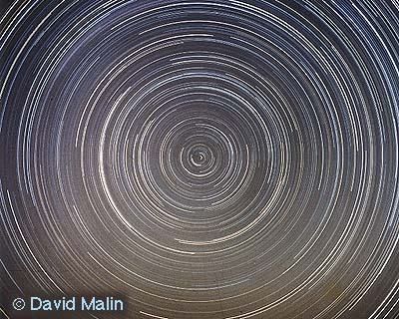
Day and Night
Claim | Evidence | Reasoning
Day and night are caused by a spinning Earth. | A photo taken of the Pole Star with a long exposure shows all the stars going round the pole star. Movement of Foucault’s Pendulum is another piece of evidence. | Either all the stars are rotating around the Pole Star (and Earth is not spinning) or the ground on which the camera sits is turning.

Slide 15
Current is Conserved
Claim | Evidence | Reasoning
Current is conserved in a simple circuit. | When you measure the current in a simple circuit before and after a bulb with an ammeter, both readings are identical. | If current was “used up” in the circuit, then the ammeter would read a lower current in the wire after the bulb compared with before the bulb.

Slide 16
Plants → CO₂ in O₂ Out
Claim | Evidence | Reasoning
Plants take in carbon dioxide and give out oxygen during photosynthesis. | Oxygen: If you collect gas in a sealed jar of elodea (a plant) illuminated by light, the gas will relight a glowing wood splint. More recently oxygen and carbon dioxide probes have become available for conducting experiments with plants in the classroom | Pure oxygen is more flammable than air, so there is a higher concentration of oxygen in the sealed jar with the plant that has been illuminated.

Slide 17
Now You Try --- Pangaea
Claim: About 250 million years ago, land on Earth consisted of one supercontinent.
Use information in the graphic on the next slide to describe some evidence and reasoning for the claim.

Slide 18
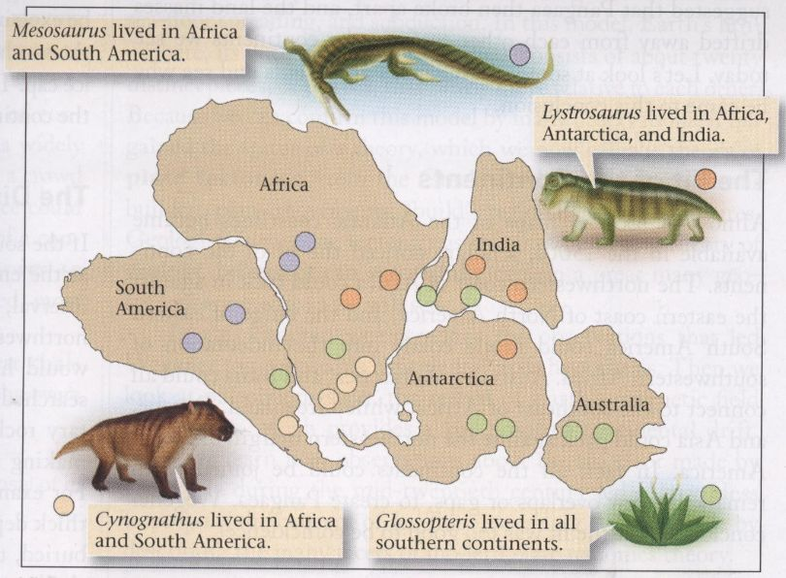
Describe Evidence & Reasoning
Colored dots show where fossils of land mammals and plants that lived 250 million years ago have been found.

Slide 19
Why Teach With Argumentation?
Was it easy or difficult to think of the evidence and reasoning for these claims?
Do you think high school students would be able to think of evidence and reasoning for these claims?
What do answers to the questions above show about:
  How the public understands science?
  The way in which science is commonly taught in schools?
What might be the value of using a more evidence-based approach?

Slide 20
Now to the video! http://www.pbs.org/wgbh/evolution/library/10/4/l_104_07.html
Hygiene Hypothesis

Slide 21
What scientific Argument did Dr. von Mutius (and the narrator) make?
  What was her claim?
  What was her evidence?
  What was her reasoning?

Slide 22
What scientific Argument did Dr. von Mutius (and the narrator) make?
  What was her claim?
If you live in an environment with fewer microbes, this will lead to higher asthma and allergy rates.
Cleaner environment makes students allergic.
  What was her evidence?
Samples and survey data of environment, more livestock interaction correlated with lower incidence of allergies
  What was her reasoning?

Slide 23
What socioscientific issue or issues is this scientific argument relevant to?
If you wanted to decide what ought to be done about the socioscientific issue you’ve identified, what other scientific questions in addition to the one in the video would you want to consider?
What non-scientific questions would you want to consider?

Slide 24
What socioscientific issue or issues is this scientific argument relevant to?
If you wanted to decide what ought to be done about the socioscientific issue you’ve identified, what other scientific questions in addition to the one in the video would you want to consider?
  Is there a corr. Between hand santizer and illness?
  What about in a different environment? Different animals? Different densities of people?
  Are children in daycare setting able to better fight off germs? Have less asthma/allergies?
  What are the incidence rates of these things in different places?
  What are the rates of infectious disease in these places?
What non-scientific questions would you want to consider?
  Is it related to the number of doctors we have? Is this a matter of over diagnosis?
  Should we spend money on allergy shots?

Slide 25
Using Science In Decision-Making
Activity Two
Students read articles (jigsaw possible) providing multiple arguments re a socioscientific issue
Students identify CER for each source
Students develop and apply own criteria for evaluating strength of arguments

Slide 26
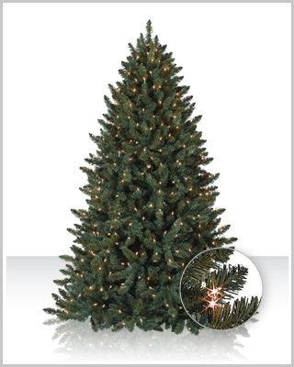
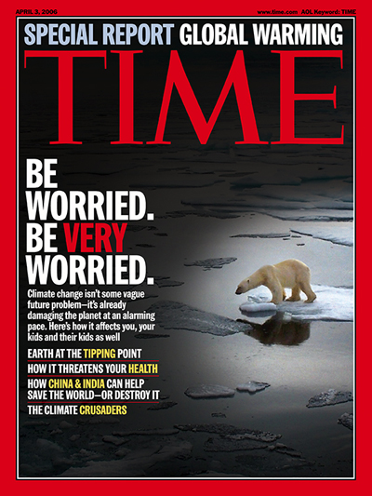
Using Science In Decision-Making
Socioscientific Issues for today
Should we buy artificial or real Christmas trees?
Are polar bears an endangered species?
Notes:
Ask teachers how they want to split up, if at all depending on attendance.

Slide 27
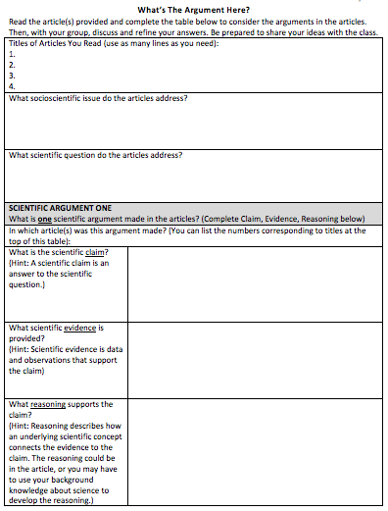
What’s the Argument Here?

Slide 28
What Makes for a Strong or Weak Scientific Argument?
How can you tell whether a scientific argument is strong or weak? Discuss with you group and list criteria (factors) below that you can think of that you would use to judge the strength or weakness of a scientific argument.
Criteria (Factors) for Evaluating the How Strong or Weak a Scientific Argument Is:

Slide 29
Evaluating Arguments in Articles
Criterion (Factor) | Strength (S), Neutral (N), or Weakness (W) | Explain why the scientific argument is strong or weak for each criterion you list.

Slide 30
What’s Your Opinion
What is your opinion about what should be done about this issue and why?
Is there anything that you could do to impact this issue? What are some things you could do and how might they impact the issue?

Slide 31
Using Science In Decision-Making
Activity Three
Students introduced to criteria scientists use
Focus is on intro/awareness, not depth
Students compare own and scientific criteria
Students revisit evaluations of sources using scientific criteria

Slide 32
Using Science In Decision-Making
Activity Three
Some Criteria Scientists Use
Scientific evidence
Sample size
Appropriate measures
Rigorous data collection
Replication
Underlying scientific concept
Consensus
Peer review
Bias
Notes:
The goal here is not for students to have a perfect understanding of how scientists evaluate arguments. Rather, this activity is intended as a first introduction to help students develop initial awareness of scientific criteria for evaluating arguments. For this reason, some of the scientists’ criteria are left intentionally a little vague.

Slide 33
Using Science In Decision-Making
Activity Four
What are some socioscientific issues that you know about and/or that are important to you?
For one issue you’ve identified, what are some scientific questions that investigating could help people understand the issue better?

Slide 34
Using Science In Decision-Making
Activity Four
Can answers to scientific questions provide us with all the information we need to make a good decision about what to do about a socioscientific issue? Why or why not?
If not, what other information would be needed?

Slide 35
Using Science In Decision-Making
Activity Four
Is there generally a right and wrong answer to what should be done about a socioscientific issue? Why or why not?
If two people had the same exact information available to them about a socioscientific issue, could they make different decisions with both being considered informed decisions? Why or why not?

Slide 36
Using Science In Decision-Making
Activity Four
Can all scientific questions be answered with 100% certainty? If not, can investigating these questions still help us to understand issues better, or is science only useful if it provides definite answers?
Has this set of activities changed the way you’ll consider scientific arguments in the future? If yes, how will what you do be different from what you’ve done before?

Slide 37
Implementing this Unit
Materials are available on the MSU Environmental Literacy website including:
  Teacher guide
  Student Handouts
  Topic packages with articles and teacher notes for each topic
  Teacher feedback form
We’d appreciate your help with data collection --- collecting completed student handouts to help us explore how students evaluate scientific arguments and evidence.

Slide 38
Implementing this Unit
Consider:
  Using the unit (starting with Activity 2) several additional times throughout school year with different topics to help students develop competencies with evaluating second-hand scientific arguments and evidence

Slide 39
Implementing this Unit
Your thoughts…
  Do you do anything similar to this already?
  Does this activity fit with your curriculum?
  How would you implement this with your students?
  What might be challenging?
  Ideas to share with each other/us about using the unit?
  What additional support would you want/need from us to use this unit?

