Slide 1
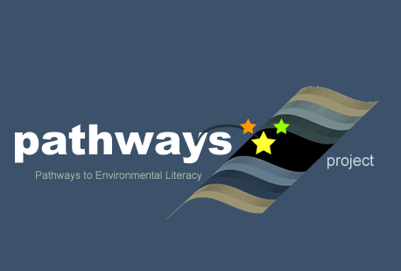

Learning Progressions: Water in Socio-Ecological Systems
Powerpoint Presentation given to teachers at summer institutes to introduce water teaching experiment
, Alan Berkowitz¹, Brad Blank², Aubrey Cano³, Bess Caplan¹, Beth Covitt⁴, Katherine Emery³, Kristin Gunckel⁵, LaTisha Hammond⁶, Bill Hoyt⁷, Nicole LaDue⁸, John Moore², Tamara Newcomer¹, Tom Noel², Lisa Pitot², Jen Schuttlefield⁹, Sara Syswerda⁸, Dave Swartz², Ray Tschillard¹⁰, Andrew Warnock and Ali Whitmer⁶.
Cary Institute¹, Colorado State Univ. ², U.C. Santa Barbara³, Univ. Montana⁴, Univ. of Arizona⁵, Georgetown Univ.⁶, Univ. Northern Colorado ⁷, Michigan State Univ.⁸, Univ. Wisconsin⁹, Poudre Learning Center¹⁰
Culturally relevant ecology, learning progressions and environmental literacy
Long Term Ecological Research Math Science Partnership
2011
Disclaimer: This research is supported by a grant from the National Science Foundation: Targeted Partnership: Culturally relevant ecology, learning progressions and environmental literacy (NSF-0832173). Any opinions, findings, and conclusions or recommendations expressed in this material are those of the author(s) and do not necessarily reflect the views of the National Science Foundation.

Slide 2


Learning Progressions
Water in Socio-ecological Systems
Math Science Partnership (MSP) Culturally Relevant Ecology, Learning Progressions and Environmental Literacy

Slide 3
Overview
What is Environmental Science Literacy?
Introduction to Learning Progressions
Some data
Trends in our data
Learning Progression –based Teaching Activities
Notes:
Today we’re going to give a brief overview of environmental science literacy and learning progressions for water in socio-ecological systems.

Slide 4
The Need for Environmental
Science Literacy
Humans are fundamentally altering natural systems that sustain life on Earth
Citizens need to understand science to make informed decisions that maintain Earth’s life supporting systems
Citizens act in multiple roles that affect environmental systems: as learners, consumers, voters, workers, volunteers, and advocates
Notes:
We live in a world today where human actions are increasingly impacting the natural systems which sustain all life on Earth. We can no longer leave decisions about actions that affect the environment to a select few policy makers and business interests. Citizens in a democracy have the responsibility to participate in both personal and collective decision making. Citizens act in multiple roles that affect environmental systems.

Slide 5
Responsible Citizenship and Environmental Science Literacy
Environmental science literacy is the capacity to understand and participate in evidence-based decision-making about the effects of human actions in socio-ecological (connected human-environmental) systems.
Notes:
Citizens make decisions based on many reasons and values. We believe that citizens should value and be able to use environmental science literacy as one basis for making decisions. Environmental science literacy is the capacity to understand and use scientific reasoning to make decisions.

Slide 6
Example Scenario: Drinking Water
A city discovers solvents in its drinking water wells.
    Where is the source of the solvents?
    How did it get into the drinking water wells?
    Could it get into a nearby river? How?
    How does it affect people?
    Could it affect plants or animals in the area?
    What is the best way to clean up the contamination?
Notes:
This is an example of a typical situation in which citizens need to be environmentally literate about water.
How does our current K-12 curriculum prepare students to answer these questions and engage in the various roles they may find themselves in as citizens?

Slide 7
Citizens Should be Able to
Trace water through connected systems at all scales (atomic-molecular to landscape)
  Structure of systems
  Processes that move water
Trace substances in water through connected systems at all scales
  Water quality
  How substances mix and unmix with water
  How and where substance move with water
Notes:
To answer these questions, citizens need to know how water moves through connected natural-human systems and how substances mix, move, and unmix from water.

Slide 8
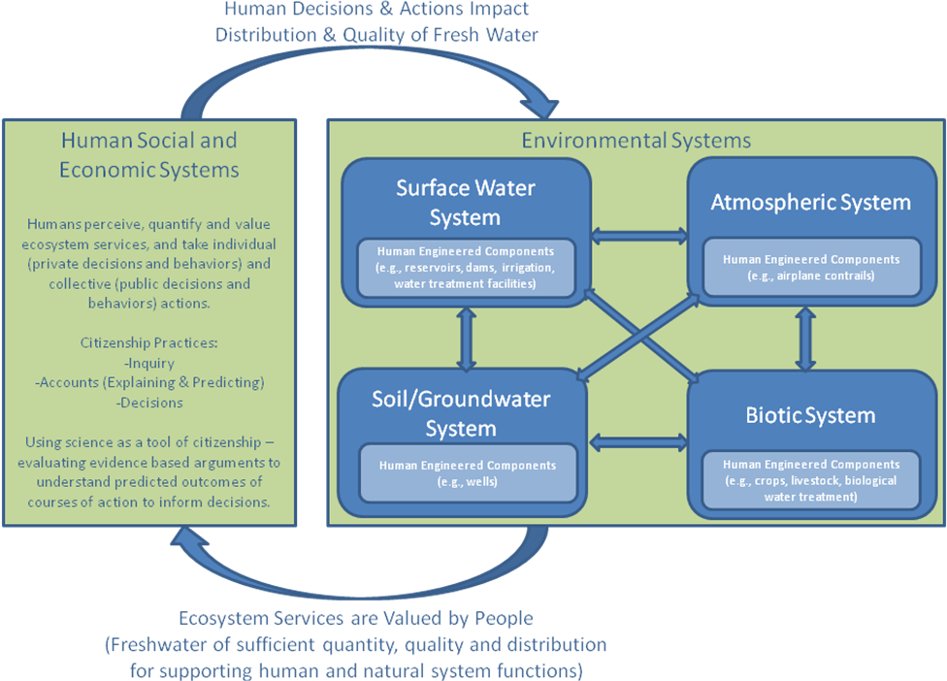
The Loop Diagram
Notes:
Here is how we think about what environmentally literate citizens need to know about water.
There are two boxes here. The right box represents all the systems through which water moves, including human systems. The arrows within the right box represent the processes that move water, such as evaporation or infiltration or precipitation. Environmental systems an important service valued and necessary for life, in this case abundant supplies of high quality fresh water. Human actions and decisions have impacts back on the water moving through environmental systems.
We argue that environmentally literate citizens should have an understanding of the structure of systems that water moves through, the processes that move water and substances through these systems, and the principles that govern the movement of water and substances. Furthermore, citizens can reason about water moving through these systems at all scales from landscapes to atomic-molecular.

Slide 9
Current K-12 Curriculum
K-5:
      Water cycle, where water is located, water conservation
6-12:
      Physical science: phase change
      Chemistry: solutions
      Earth science: weather
Missing – substantial treatment of
      Groundwater
      Watersheds
      Engineered systems
Notes:
Our current K-12 curriculum is fragmented and incomplete. It does not prepare students to address the types of questions asked about the contaminated wells scenario. We need to develop a K-12 science curriculum that prepares students to be environmental science literate citizens. This curriculum must build connected understanding among many areas of traditional science education.

Slide 10
Learning Progressions

Slide 11
Learning Progressions
High School
Connected Understanding
Middle School
Elementary School
Notes:
To build a curriculum that results in connected understandings so that students can answer the types of questions necessary to engage as responsible citizens in a scenario like the contaminated wells scenario, we need to develop K-12 learning progressions.
Learning progressions describe knowledge and practices about topics that are responsive to children’s ways of reasoning, and reflect gradually more sophisticated ways of thinking.
(Smith & Anderson, 2006)

Slide 12
Learning Progressions
Upper Anchor = Scientific Reasoning
What high school students should know and be able to do
Lower Anchor = Informal Ideas
How children think and
make sense of the world
Notes:
Learning progressions connect how students think about the world to the scientific ideas we would like them to know and be able to use when they finish high school. Learning progressions are different from scope and sequences because they start with the empirical evidence about how students see the world and trace their learning from there.
First we need to define the upper & lower anchors.
Upper anchor – what we want HS students to know and be able to do
Based on:
Cutting-edge science (too complex to be used as is)
Societal needs
What’s achievable (from educational research)
Lower anchor – how children think and make sense of the world
Based on:
Empirical research on current student understanding
Based on educational research guided by upper anchor (e.g., research reported in this talk)
Then we need to figure out reasonable steps between the upper and lower anchors that are responsive to children’s ways of thinking and reflect gradually more sophisticated ways of thinking.

Slide 13
Helps Us Think About
How do students’ ideas change from their initial ideas to more scientific answers?
What are the connections between students’ experiences and how they are thinking about concepts at different points in their K-12 schooling?
How can this knowledge help us rethink curriculum to best help students learn?
Notes:
To support students in becoming environmentally literate citizens, we need to know how students ideas and the connections they see in their experiences change as they move through school.

Slide 14
Making Sense of Student Data

Slide 15
Student Assessments
Assess student understanding of science concepts
Conduct interviews
Analyze patterns in student answers
Not about if students have right or wrong answers.
We are not evaluating teaching.
We are looking for how students make sense of their world.
Notes:
To gather the data we need to build learning progressions, we need data from students. We gather these data using assessment items and interview. We analyze patterns in student data to help us understand how student thinking changes as they go through school.
These assessments are not graded. We are NOT evaluating whether or not students have the right answer. We are NOT evaluating teachers or teaching. There may be content on these assessments that are not in your curriculum. This is because we believe that there are important aspects of thinking about water that are not included in the curriculum and we want to know how students think about these ideas. It will help us eventually advocated for and build better curriculum and standards if we understand student thinking about these ideas.
What we are doing is trying to understand how students view and make sense of their world.

Slide 16
Student Data
How does water get into a river?
If you had to make ocean water drinkable, how would you do it?
How does water get into well #1?
What happens to salt when it dissolves in water?
Notes:
Stop Here
Hand out samples of student data. Have teachers work in groups to order responses. Have teachers discuss reasons for orders. Emphasize trying to think about how students are reasoning, not if they got the answer right or wrong.

Slide 17
Levels of Achievement
Levels of Achievement | Progress Variables
 | Moving Water | Substances in Water
4: Qualitative model-based accounts | Traces water through connected systems (multiple pathways/scales). Applies principles that govern movement of water. | Identifies and traces substances mixing, moving, and unmixing with water (multiple pathways/scales). Applies principles to reasoning about substances in water.
3: “School science” narratives | Tells school science narratives. Has difficulty describing processes at atomic-molecular scale. Does not use principles. | Tells school science narratives. Has difficulty describing processes at atomic-molecular scale. Does not use principles.
2: Force-dynamic narratives with hidden mechanisms | Recognizes water can move and that there are hidden mechanisms moving water. Uses force-dynamic thinking that invokes actors or enablers. | Recognizes water quality can change. Thinks of water quality in terms of bad stuff mixed with water. Invokes actors or enablers to change water quality.
1: Force-dynamic narratives | Views water as part of the background landscape with natural tendencies (e.g. flows). Does not view water in a location as connected to other water. | Views water quality in terms of types of water (e.g. dirty water).
Notes:
Here is the framework for our learning progression. We have divided the learning progression into four levels. Level 1 is the lower anchor and level 4 represents what we want students to know and be able to do by the end of high school.
Our learning progression traces student ideas along two progress variables – how they think about water moving through systems and how they think about substances in water moving through systems.
In the boxes are characteristics of student thinking at these levels.
The next few slides give some examples from the data.

Slide 18
Contrasting Awareness of the World
 | Lower Anchor (Informal Ideas) | Upper Anchor (Scientific Ideas)
Awareness of world | Focus on personal and immediate experiences | Awareness and knowledge of connected human engineered & natural water systems & structures.
How does water get into a river? | By digging a hole and the rain, snow, or ice melts and the water will drain in the river. | Runoff from when it rains goes into the river, and also water gets through the earth and becomes groundwater. That flows to the river as well.
Notes:
Here are some patterns we see in our data. Students at the lower anchor have a different awareness of the world around them than students at the upper anchor. Students at the lower anchor focus on their immediate and personal experiences, while scientific thinking recognizes that there are parts to systems that are connected and water and substances move through those connected systems.
We see that here in these answers. The student who gave the response at the lower anchor is reasoning from a personal experiences he or she may have had with water, while the student who gave the upper anchor response recognizes the ways that water moves through connected systems.

Slide 19
Contrasting Ideas of Scale and Visibility/Invisibility
 | Lower Anchor (Informal Ideas) | Upper Anchor (Scientific Ideas)
Scale & visibility / invisibility | Focus on visible/macroscopic world. | Recognition of matter and processes across scales (atomic-molecular to landscape). Recognition of invisible & hidden matter, structures & processes.
What happens to salt when it dissolves in water? | The water overpowers the salt by making it disappear. | The H₂O is negatively charged so Na⁺ is attracted like a hydrogen bond and the NaCl will break apart.
Notes:
Similarly, students using informal ideas think about only the visible/macroscopic parts of the world. Once something is not longer visible, it is gone. The upper anchor response recognizes that matter can exist in invisible forms or in hidden places. They can also think about matter at the atomic-molecular scale
(note, if someone comments on the drawing, you can acknowledge that the drawing is not exactly correct, but the student does recognize that matter is composed of molecules and ions and that there are electrostatic forces at work).

Slide 20
Contrasting Reasoning
 | Lower Anchor (Informal Ideas) | Upper Anchor (Scientific Ideas)
Overarching Discourse | Force Dynamic : Actors can (people, animals) make things happen with the help of enablers. | Scientific: Systems composed of enduring entities (e.g., matter, energy) change according to laws or principles (e.g., conservation laws).
If you had to make ocean water drinkable, how would you do it? | I would have a purifying machine. | To make ocean water drinkable you would have to distill the water because when you distill it the salt is what is left behind.
Notes:
For the student using informal reasoning, the response to this question is that an actor can make drinking water by using a machine. Issues of matter and energy are not considered. Compare this with the second example… This person (actually a teacher) understands this question very differently. The world is a place where scientific principles such as conservation of matter and energy must be applied.

Slide 21
Contrasting Explanations of Events
 | Lower Anchor (Informal Ideas) | Upper Anchor (Scientific Ideas)
Explaining Events | Events are human-centered dramas. Water in landscape serves needs of and is manipulated by actors. Proximity and connectedness are often explanations – easier to act on something close by. | Events explained using principles to govern processes and model-based reasoning.
Notes:
(this slide and the next slide go together).
In terms of explaining events, students at the lower anchor use human-centered dramas. They also give reasons in terms of connectedness or proximity. Students at the upper anchor recognize the ways principles govern processes.

Slide 22
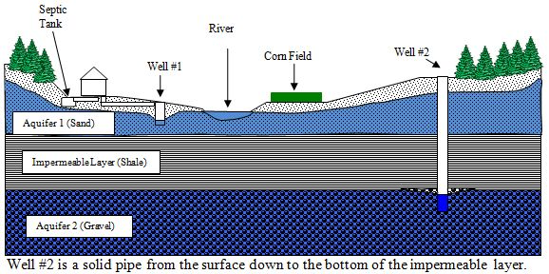
Contrasting Explanations of Events
 | Lower Anchor (Informal Ideas) | Upper Anchor (Scientific Ideas)
How does water get into well #1? | From the septic tank and when it rains. From the sinks. From the Bath Tubs. From the towilets | The Rain pathway goes into Well 1 by Raining in the river and going into the aquifer to Well 1. The river pathway goes from the river into the aquifer and into Well #1. The Aquifer 1 path goes from the aquifer to the well.
Notes:
Note that the informal answer relies on humans and human actions. Also, it only describes sources of water. The upper anchor response traces water along multiple possible pathways. It identifies sources and describes pathways.

Slide 23
Learning Progression-based Teaching Activities
Notes:
We are now ready to start thinking about how instruction can help support students in developing more scientific ways of thinking about water in socio-ecological systems. We are going to do that by asking you to teach some activities that highlight some of the characteristics of scientific thinking that we want students to attend to.

Slide 24
Water Budget
Describes the quantity of water entering (inputs), stored in, and leaving (outputs) a given place over a given period of time.
Accounts for ALL of the pathways of the water coming into, staying and leaving, in all forms.
Notes:
Our activity is based on the idea of a water budget. A water budget accounts for all of the water that enters a given place over a given time. It is like a bank account statement that shows all the money coming in and going out.
In a water budget, we account for all the pathways water takes coming into and go out of a specific place.

Slide 25
Title
Type of Material (Student/PD/Assessment/etc.)
, Alan Berkowitz¹, Brad Blank², Aubrey Cano³, Bess Caplan¹, Beth Covitt⁴, Katherine Emery³, Kristin Gunckel⁵, LaTisha Hammond⁶, Bill Hoyt⁷, Nicole LaDue⁸, John Moore², Tamara Newcomer¹, Tom Noel², Lisa Pitot², Jen Schuttlefield⁹, Sara Syswerda⁸, Dave Swartz², Ray Tschillard¹⁰, Andrew Warnock and Ali Whitmer⁶.
Cary Institute¹, Colorado State Univ. ², U.C. Santa Barbara³, Univ. Montana⁴, Univ. of Arizona⁵, Georgetown Univ.⁶, Univ. Northern Colorado ⁷, Michigan State Univ.⁸, Univ. Wisconsin⁹, Poudre Learning Center¹⁰
Culturally relevant ecology, learning progressions and environmental literacy
Long Term Ecological Research Math Science Partnership
Date of this Version
Disclaimer: This research is supported by a grant from the National Science Foundation: Targeted Partnership: Culturally relevant ecology, learning progressions and environmental literacy (NSF-0832173). Any opinions, findings, and conclusions or recommendations expressed in this material are those of the author(s) and do not necessarily reflect the views of the National Science Foundation.

Slide 26
Place-based:
School Yard Water Budget
Where does the water that falls on your school yard go?
What are the pathways that the water follows?
Why does it go that way?
How much water goes that way?
Notes:
This activity uses place-based learning. We know that situating learning in the local place helps students learn better.
The place we will look at is your specific school yard. We want student to think about where the water goes, what pathways it follows, and how much water follows each pathway. We also want students to reason about why the water follows those pathways.

Slide 27
Pathways, Processes, and Principles
Which pathways water follows and how much of the water follows that pathway depends on processes and principles that govern processes.
  Runoff- Topography/ slope / gravity
  Infiltration - Permeability of groundcover
  Transpiration - Vegetative cover
  Evaporation - Temperature and humidity
  Conservation of matter
Notes:
Which pathways water follows and how much of the water follows that pathway depends on processes and principles that govern processes. These are the processes and principles that we focus on in this activity.

Slide 28
Quantitative Reasoning
Representations for spatial reasoning (maps)
Representations of ratios and proportions (pie charts)
Notes:
We also are working on student quantitative reasoning. This activity engages students in using spatial represenatation by using maps of the school yard. Student think about budgets in terms of dividing up a whole. We have them use pie charts to think about ratios and proportions.

Slide 29
Our Hypothesis
Instruction that makes pathways, processes, and principles explicit and visible to students will help students move towards scientific reasoning about water in socio-ecological systems.
Notes:
Our hypothesis is that instruction that makes pathways, processes, and principles explicit and visible to students will help students move towards scientific reasoning about water in socio-ecological systems.

Slide 30
Your Participation
Participate in and learn the Water Budget Activities
Participate in discussions about how to engage students in these activities.
Administer pre -assessments to students
Teach these activities with your students
Administer post-assessments to students
Notes:
We are asking for your participation in the development of this learning progression. We value your time, knowledge, experience, and ideas in helping us with what we hope you will see as important and necessary research.

Slide 31
Questions?

