Slide 1
Teachers’ Use of Learning Progression-Based Formative Assessment in Water Instruction
Beth Covitt, University of Montana
Sara Syswerda, Pierce Cedar Creek Institute
Bess Caplan, Cary Institute of Ecosystem Studies
Aubrey Cano, University of California Santa Barbara
NARST Annual Meeting
March 31, 2014

Slide 2
Learning Progression-Based
Formative Assessment
Promise
Support interpretation of students’ ideas & provide guidance for responding w/ instruction that builds on conceptual resources
Challenge
Few LP-based instructional materials
Requires knowledge & practices not common among teachers today

Slide 3
Requisite Knowledge & Practice
Understanding of an LP including…
  Characteristic ways of knowing across levels
  Challenges associated w/ transitions
Capacity to…
  Elicit & interpret students’ ideas w/respect to LP
  Identify appropriate learning goals
  Design/enact instruction that builds on strengths & responds to challenges

Slide 4
Study
Multiple case study
  2 teachers
  1 middle school (Laurie), 1 high school (Jen)
  Participating in NSF-funded LP-based PD project
Both taught School Water Pathways unit
Study focused on use of School Map FA w/in unit
Case teachers are contextualized w/in a larger data set

Slide 5
Research Questions
How do teachers…
Understand water systems LP and use it in instruction?
Describe purpose of formative assessment?
Interpret students’ ideas w/respect to LP framework?
Respond to students’ ideas w/instruction?

Slide 6
Water Systems Learning Progression
Level 4: Scientific Model-Based Reasoning
  Accounts are explanations governed by driving forces & constraining factors
Level 3: School Science / Phenomenological Reasoning
  Accounts are descriptions of ordered events and processes
Levels 1 & 2: Force-Dynamic Reasoning
  Accounts describe actors with purposes, helped by enablers

Slide 7
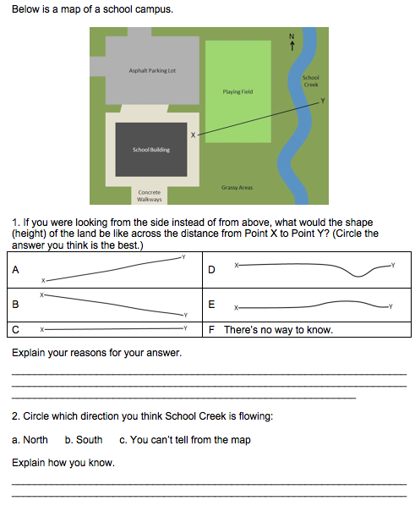
School Map FA
L | Uses…
4 | Principle-based understanding of drivers (gravity) & constraints (topography) to make inferences about shape of land & direction of flow
3 | School science stories (e.g., rivers flow into lakes) to interpret map & direction of flow
2 | Force-dynamic interpretation of map (water wants to flow to connected places)

Slide 8
Data Sources
Pre & post-instruction teacher interviews
Lesson observations & videos
Completed student formative assessments
Teacher written assessments addressing science content knowledge & pedagogical content knowledge (PCK)*
*Assessments for case teachers plus 153 project teachers

Slide 9
Data Analysis
Case Study Data
Identified excerpts reflecting themes from research questions.
E.g., for instruction research question…
  What reasons does teacher give for instructional choices?
  How does teacher use knowledge of student ideas in planning?
Science Content & PCK Assessments
  Science content coded on 4-pt LP scale using previously validated procedure (Gunckel, et al., 2012).
  PCK coded on 3-pt scale, coders came to consensus for all responses.
    Category A: PCK not aligned with LP or big ideas
    Category B: PCK associated with teaching for school science accounts
    Category C: PCK associated with teaching for model-based reasoning

Slide 10
Target for Interpreting Students’ Ideas
Students responding at L2 understand map represents a landscape, but have trouble connecting map to 3-D shape of land
Students responding at L3 make inferences about shape of land from map, but fail to govern inferences using drivers & constraints

Slide 11
Target Instructional Response
Effective response provides…
1st hand experiences connecting 3-D landscapes w/ maps
Support in reasoning w/ drivers & constraints

Slide 12
Jen’s Interpretation of Student Ideas
(Pre-interview) Some of them were able to use kind of common sense and figure out the answer before we even talked about stuff, so that was pretty good. Some of them did assume water was flowing north to south regardless of what was going on around the water or the schoolyard. Some gave answers that were completely off the wall… More of them answered with a solid answer than I thought would so I was actually surprised at their results, how good they were.

Slide 13
Jen’s Instructional Response
(Lesson Dialogue) Open your notebooks and turn to your notes section. I’m going to show you a quick PowerPoint. Rather than having a separate vocab list, we’re just going to hit the vocab as we go through. Most of the stuff is probably words you guys have seen before, but it’s going to give it a definition.

Slide 14
Laurie’s Interpretation of Student Ideas
(Post Interview) I saw that most of the student responses were around a 2.5.
Common ideas were that the landscape is a straight line and that either the water is flowing south or you can’t tell from the map.
Having developed spatial relations and transferring 3-D space onto a 2-D space is still difficult at the 6th grade level.

Slide 15
Laurie’s Instructional Response
(Post Interview) Their reasoning was that if they were standing and looking at the river it would be a straight line, which indicates they are not taking into account terrain and the 3-D landscape. What I did to address this misconception was to first pull out a watershed model and discuss with students the path water takes when traveling downhill and why it takes that path. We also discussed how, in the model, the rivers (or paths the water flowed down) were indented and at a lower elevation than the area surrounding the river path.

Slide 16
Synopsis of Cases
Facet | Jen | Laurie
Under-standing of LP | Responses & talk reflect L3 w/access to L4 Sees LP as useful for supporting learning w/implicit goal of L3 accounts | Responses & talk reflect L4 w/ minor problems Views LP as tool for planning instruction that builds students’ ideas through experience.
Purpose of FA | Views learning as acquisition of facts. FA allows her to assess facts students do/don’t know so she can cover appropriate content | Situates FA practice w/in LP (identifying students’ LP-aligned ideas & practices)

Slide 17
Synopsis of Cases
Facet | Jen | Laurie
Interpreting students’ ideas | Recognizes student challenges, but does not situate w/in LP. Interprets ideas as right/wrong. | Describes what students know & do, as well as specific challenges (i.e., spatial reasoning). Situates responses in LP.
Instructional response | Consistent w/ teaching for L3 Didactic Focuses on vocab rather than principles Does not address students’ need for 1st hand experience | Provides relevant experience w/ 3-D watershed model to respond to challenge w/spatial reasoning. Connects to local area to support reasoning from personal experience.

Slide 18
Project Teacher Knowledge & Practice
Item | Level/Category | 2011-12 (N=98) | 2012-13 (N=55)
Science Content | 1/2 | 20% | 21%
 | 3 | 61% | 65%
 | 4 | 19% | 14%
Learning Goals | A | 47% | 32%
 | B | 49% | 59%
 | C | 4% | 9%
Interpreting Students’ Idea | A | 28% | 11%
 | B | 60% | 72%
 | C | 12% | 17%
Instructional Response | A | 32% | 23%
 | B | 53% | 64%
 | C | 15% | 13%

Slide 19
Interpretation
Many teachers demonstrate knowledge & practice that aligns w/ instruction likely to support Level 3 school science descriptions rather than Level 4 model-based reasoning.
Teachers like Jen bring strengths including valuing…
  Understanding students’ ideas
  Helping students become “deeper thinkers”
  Helping students develop accurate accounts

Slide 20
Conclusion
Promise of LPs depends, in part, on PD efforts that build on teachers’ strengths & help them develop more challenging LP-aligned knowledge & practice that support student learning toward model-based reasoning.

Slide 21
Questions & Queries
Paper may be accessed at…
  www.pathwaysproject.kbs.msu.edu
For questions, contact Beth Covitt at…
  beth.covitt@umontana.edu
  This research is supported by grants from the National Science Foundation: Targeted Partnership: Culturally Relevant Ecology, Learning Progressions and environmental literacy (NSF-0832173), and Tools for Reasoning about Water in Socio-ecological Systems (DRL-1020176). Any opinions, findings, and conclusions or recommendations expressed in this material are those of the author(s) and do not necessarily reflect the views of the National Science Foundation.

