Slide 1

Promise and Problems of Learning Progression-guided Interventions
Hui Jin, Hyo Jeong Shin, Michele Johnson, Jinho Kim

Slide 2
Overview
  Carbon Cycle Teaching Experiment: Using knowledge of photosynthesis & cellular respiration to explain plant growth
  Tracing matter
  Tracing energy
  Connecting scales
Motivations
  Validation LPs vs. Evolutionary LPs (Duschl, Maeng, & Sezen, 2011). Evolutionary LPs can be aimed at either knowledge enrichment or conceptual change depending on “different conditions of prior knowledge” (Chi, 2009).
  → Conceptual change-oriented learning progression
  Very few learning progression studies explore teacher’s role in interventions (e.g. Furtak, 2012; Thompson, Braaten, & Windschitl, 2012). Teachers are agents who enact curriculum in class.
  → Explore teachers’ role in LP-guided interventions.
Notes:
Progress variables
Not simply an enrichment LP to fill in missing or incomplete prior knowledge
Duschl identified two learning progressions… We argue that…
The majority LP studies focus on student learning, while very few…
1 min

Slide 3
Research Questions
Student Outcomes: What are students’ learning outcomes in an intervention guided by a conceptual change-oriented Learning Progression Framework (LPF)? What learning difficulties do students have?
Teacher Knowledge: How do we develop LPF-based measures of teachers’ CK (content knowledge) and PCK (Pedagogical content knowledge)? What is teachers’ achievement in the CK and PCK assessments?
Teachers’ Impact on Student Outcomes: Is teachers’ CK and PCK linked to students’ outcomes? How? What are some other factors affecting student outcomes?
Notes:
1 min

Slide 4
Development Process
The LPF served as a guide in the design of a coordinated set of resources:
  Student Assessments
  Teacher Assessment
  Teaching unit
  Professional Development programs and resources
Notes:
This is transitional slide. (10 second)

Slide 5
Explanation Practice:
Learning Progression Framework (LPF)
Phenomena
Level 4. Tracing Matter; Tracing Energy; Connecting Scales
Level 3. Reasoning about Matter and Energy Unsuccessfully
Plant Growth
Plants gaining mass
Gas exchange (CO₂ and O₂)
Level 2. Hidden Mechanisms Reasoning
Level 1. Force-dynamic Reasoning
1. Student Assessment
7 Tracing Matter Items
3 Tracing Energy Items
4 Connecting Scales Items
2. Teacher Assessment
CK Items: 6
PCK Items: Analyze responses at Levels 1, 2, and 3; 3 Knowledge of student thinking items; 3 Next instructional move items
Notes:
We used a learning progression framework, LPF, to describe student development in explaining two phenomena about plant growth: plants gaining mass and gas exchange between oxygen and carbon dioxide. This LPF guided the design of student assessment and analyses. It has four levels….
The student assessment contains items focusing on tracing matter, tracing energy, and connecting scales. We also used the LPF to design teacher assessment. Basically, we provided student responses at Level 1, 2, or 3, and ask teachers to ask follow-up questions or make decision on a next instructional move.

Slide 6
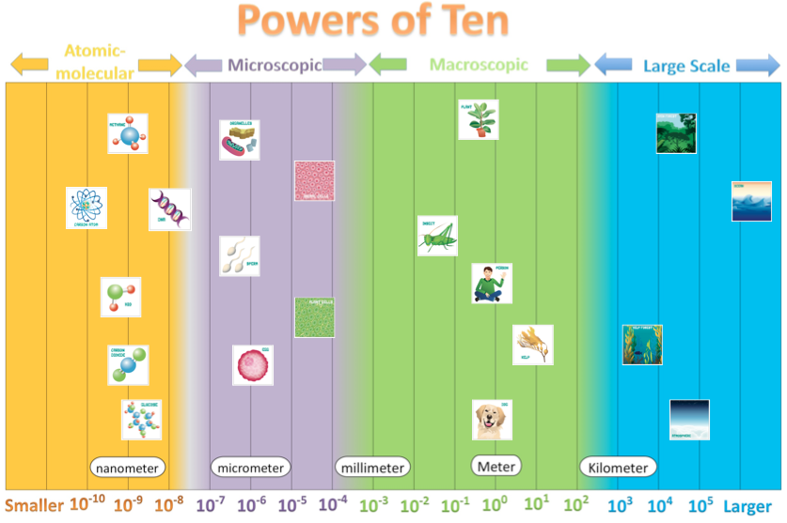
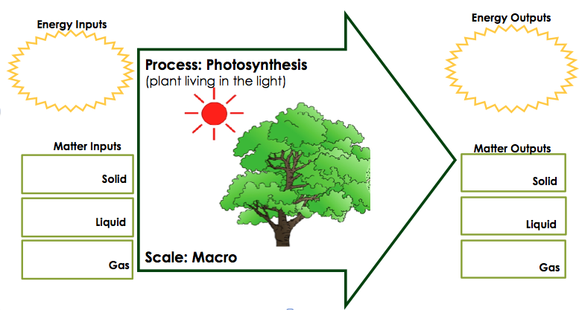
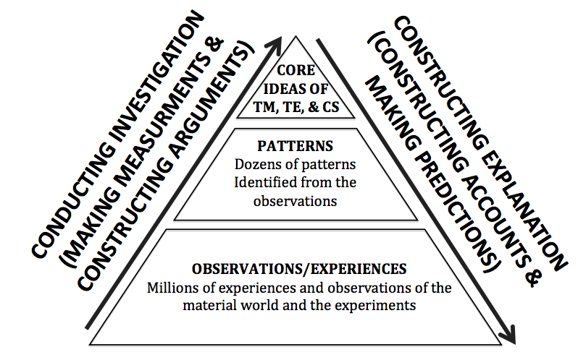
Explanation Practice
Learning Progression Framework (LPF)
3. TEACHING UNIT
To promote conceptual change
Level 4. Tracing Matter; Tracing Energy; Connecting Scales
Level 3. Reasoning about Matter and Energy Unsuccessfully
Tracing Matter; Tracing Energy
Level 2. Hidden Mechanisms Reasoning
Connecting Scales
Level 1. Force-dynamic Reasoning
To engage students in scientific practices
4. PROFESSIONAL DEVELOPMENT
http://www.pathwaysproject.kbs.msu.edu/?page_id=59
Notes:
The teaching unit has two goals. Goal 1. We used two tools of reasoning to help students make the transition from a lower level, level 1, 2, or 3 to level 4. The matter and energy process tool helps students develop the ability to trace matter and energy. The powers of ten tool help student develop the ability to connect scale.
Goal 2, We promote students’ conceptual change through engaging them in investigation and application activities (making predictions, developing explanations)
The professional development programs and resources are used to help teachers understand the LPF and the unit.

Slide 7
Data Sources & Analysis
Research Components | Student Outcomes | Teacher Knowledge | Teachers’ Impact on Student Outcomes
Data | Pre- and post-assessments from students (2011-12: 605 students; 2012-13: 380 students) | CK & PCK assessments from teachers (2011-12: 120 teachers; 2012-13: 74 teachers) | Pre- and post-student assessments (2011-12: 598 students; 2012-13: 380 students) CK & PCK assessments from teachers who taught these students (2011-12: 15 teachers; 2012-13: 10 teachers) Feedback forms from 11 teachers who were identified as low-performing/high-performing teachers
Analyses | Use LPF to code data Apply IRT Analyses to the coding results | Use a LPF-based PCK Rubric to code data Apply IRT Analyses to the coding results | Qualitative & Quantitative Analyses
Notes:
As Michele talked about, the study has three components. We conducted two cycles of research. In each cycle, we collected and analyzed data to answer the research questions about each component. For student outcomes, we used the LPF to code students’ responses in the pre- and post- assessments, and applied IRT analyses to the coding results. For teacher knowledge, we developed a PCK rubric to code teachers’ CK and PCK responses, and applied IRT analyses to the coding results. To study teachers’ impact on student outcomes, we analyzed three datasets, including student assessments, CK & PCK assessments from teachers who taught these students, and feedback forms from teachers who were identified as low/high performing teachers. We used both qualitative and quantitative analyses.
1 min

Slide 8
LPF-based PCK Rubrics
Levels | Teacher Responses | Alignment with the student LPF
4. Targeting the transition from naïve ideas to scientific big ideas | A student responds, “Along with soil, plants use carbon dioxide, sunlight, and water to help them make food.” Which of the following question would you ask next? b. Where does carbon dioxide go? b. By asking where the CO2 goes during the process, I am looking to see if students understand that carbon is the backbone of organic molecules. I am a little uncomfortable asking where plants get food as that might lead students to think about fertilizer as food. | → Level 4 understanding of the LPF & understanding of students’ ideas at Levels 1, 2, & 3 of the LPF.
3. Targeting scientific big ideas | a. How is your explanation related to photosynthesis? My looking at photosynthesis one will need to answer the other questions. The formula for photosynthesis is a central theme to the question. | → Level 4 understanding at the LPF
2. Content-specific approach | In a lesson on food, students debate whether or not water is food for plants. Which one of the following would be the best next instructional step? b. Cut open a cactus to show students that water is stored inside. This would show the storage of water, thus using it for food. | → Level 3 understanding of the LPF.
1. Content general approach | D. Have students observe two plants, only one of which is watered, over a period of a week. It is an experiment and has results
Notes:
This is a LPF-based PCK rubric that was developed based on teacher PCK assessments. At Level 1, teachers focus on general features of instruction or student understanding. At level 2, teachers begin to consider teaching content and if student understand content, but they often do not identify the big ideas or have content errors themselves. Therefore, this level is aligned with Level 3 of LPF. At level 3, teachers are able to evaluate students’ responses and make decision on instruction based on the scientific big ideas, that is, tracing matter and energy and connecting scales. However, they do not understand students’ intuitive ideas described at Level 1, 2, or 3. Therefore, this level is aligned with Level 4 of the LPF. At level 4, teachers understand both the scientific idea described at level 4 of the LPF and intuitive ideas described at levels 1, 2, and 3 of the LPF.
1.5 min

Slide 9
Findings
Student Outcomes
Teacher Knowledge
Teachers’ Impact on student outcomes
Notes:
10 seconds

Slide 10
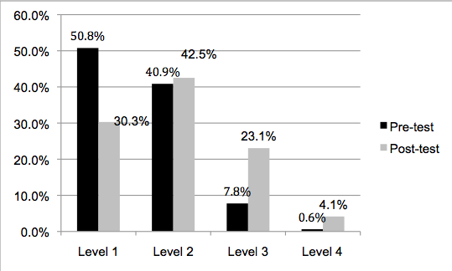
Student Learning Gains
IRT Analyses
Distribution of Students’ Responses
 | Pre | Post | Gain
2011-12 | -0.38 | 0.40 | 0.72**
2012-13 | -0.42 | 0.75 | 1.17**
** p<0.001
Notes:
The data of two years show significant learning gains. The figure of distribution of responses shows that in the post-test shows that level 1 responses dropped in the post-assessment, and level 3 responses increased notably in the post-assessment. As elaborated above, responses at level 1 and level 2 are primarily force-dynamic in nature, while responses at level 3 reason about matter and energy. Therefore, the evidence suggests that a considerable number of students, who received the treatment, were able to make the transition from force-dynamic reasoning towards transitional reasoning about matter and energy. The figure also shows that the percentage of responses at level 4 increased significantly but the percentage of level 4 responses in the post-assessment is very low. This suggests that either longer or more effective treatment should be conducted to scaffold the majority students to achieve model-based reasoning.
1 min

Slide 11
Teacher Knowledge: General Pattern
Notes:
About 61% CK responses are at Level 4 and about 48% PCK responses are at Level 4. For PCK, Level 4 refers to that the teacher understanding Level 4 of the LPF and also understand students’ responses describe at lower levels of the LPF. So, this indicates that most teachers were able to identify the scientific core idea related to students’ responses, but analyzing students’ responses is more challenging for teachers.
1 min

Slide 12
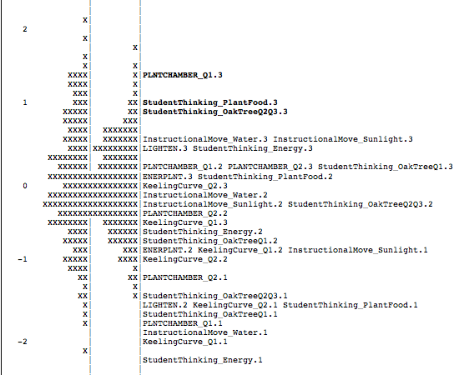
Teacher Knowledge: The Most Difficult Items
CK
PCK
CK
PCK
Notes:
We created a Wright Map based on the coding results. It shows person ability on the left side matched with item difficulty on the right side. We identified the most difficult items based on the Wright map.
0.5 min

Slide 13
Teacher Knowledge: The most difficult PCK items
The easiest item (Identifying incorrect description of content): During a discussion about how plants and animals get energy, one student says, “I know animals break down food to get energy, but I don’t think plants break down food for energy because they get light energy from the Sun.” What, if anything, is wrong with this student’s statement?
The most difficult item (Identifying naïve ideas of students): A teacher asks students where plants get their food. A student responds, “Along with soil, plants use carbon dioxide, sunlight, and water to help them make food.” In order to find out more fully how the student’s ideas of how matter is transformed when plants grow, which of the following question would you ask next?
Notes:
Here, we only discuss the most difficult PCK items. There are two most difficult items. Both of them are about understanding students intuitive ideas. We compare one of these item with the easiest item of the assessment, to show why these two items are so challenging for teachers. Each item asks teachers to analyze a response from students. The student response in the easiest item indicate that the student does not recognize that plants also break down food in cellular respiration. For the most difficult item, the teacher needs to understand that food has two meanings. In science textbook, food refers to organic substances produced in photosynthesis. In students’ mind, food is everything a plant takes, including water, soil, air, and so on.
1 min

Slide 14
Teacher Knowledge and Student Learning Gains
The association of teacher knowledge and student learning gains is statistically significant
  Teachers with average knowledge level (combined CK & PCK scores) produced a significant learning gain in their students:
    0.59 logits (p<0.001) for 2011-12
    1.13 logits (p<0.001) for 2012-13
  Teachers who had one logit higher knowledge produced an additional increase in student learning gain:
    0.36 logits (p<0.001) for 2011-12
    0.34 logits (p<0.001) for 2012-13.
Notes:
We studied the linkage between teacher knowledge and student learning gains and found the association between them is statically significant.
0.5 min

Slide 15
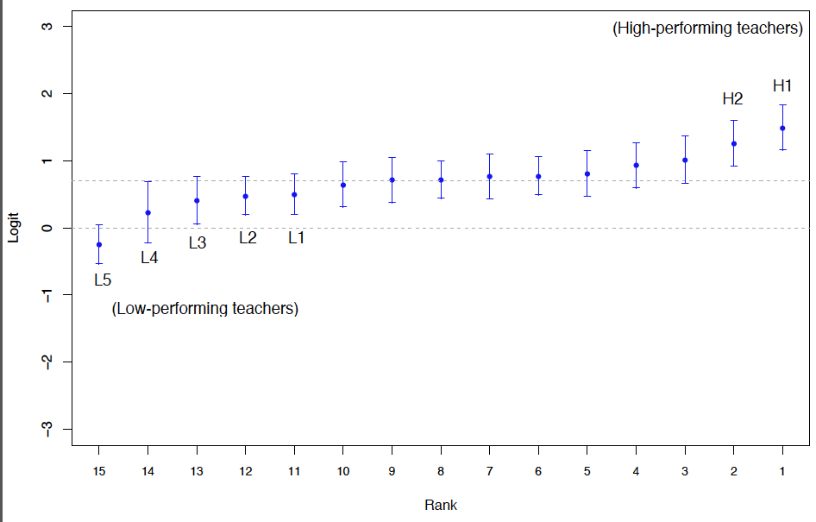
Identify High/Low performing Teachers
2011-12 Data
Average learning gain
Zero learning gain
Notes:
We also identified and compared two groups of teachers: low-performing teachers who produced low student learning gains and high-performing teachers who produced high student learning gains in the teaching experiments. The figure shows average learning gains and associated 95% confidence interval for each individual teacher for 2011-12. This is zero learning gain. This is average learning gain.
Here we identified low-performing teachers and high-performing teachers. The confidence intervals of these two groups of teachers are not overlapped.
1 min

Slide 16
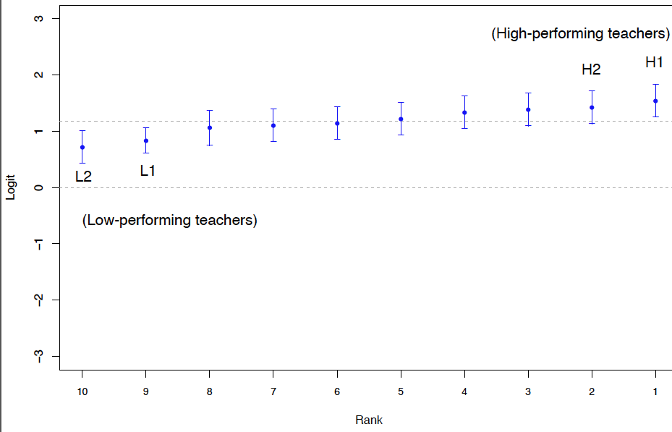
Identify High/Low performing Teachers
2012-13 Data
Average learning gain
Zero learning gain
Notes:
We used the same approach to identify the two groups of teachers for 2012-12.
10 seconds

Slide 17
Compare High-performing teachers with low-performing teachers
Feedback forms from 7 High performing teachers & 4 Low performing teachers
  Low-performing teachers taught 6, 7, or 8 lessons
  High-performing teachers taught 10 or 11 lessons
  Teacher H1 (highest learning gain) taught only 5 activities, but produced the highest learning gain in 2012-13. Feedback from suggests that the teacher used similar activities to replace activities in the curriculum
The coverage of curriculum is positively associated with student learning gains.
Notes:
We analyzed the feedback forms of the two groups of teachers. We found that they taught different numbers of lessons. There is only one exception. The feedback from of teacher H1 suggest that he used similar activities to replace the activities in the unit.
1 min

Slide 18
Implications
The LPF was the basis for developing an intervention that enabled students to learn significant knowledge and practices in an important domain.
We developed LPF-based measures of teachers’ CK and PCK, and those independently contributed to students’ learning.
Teachers’ classroom practices also made a difference, at least in terms of the coverage of curriculum. We are currently analyzing teachers’ classroom teaching videos to examine how teaching practice affect learning outcomes.
Notes:
0.5 min

Slide 19
Questions?
Find manuscript, presentations, curriculum and PD resources at:
  www.pathwaysproject.kbs.msu.edu
Further questions, contact:
  Hui Jin: jin.249@osu.edu; Michele Johnson: mkiss@ucsb.edu
This grant was funded by the National Science Foundation (NSF) under grant number DUE-0832173. The views expressed here are those of the authors and do not necessarily reflect those of NSF.

