Slide 1
Teachers’ Uses of Learning Progression-Based Tools for Reasoning in Teaching about Water in Environmental Systems
Kristin L. Gunckel, University of Arizona
Beth A. Covitt, University of Montana
Ivan Salinas, University of Arizona
NARST
March 31, 2014

Slide 2

Research Support Disclaimer
This research is supported by grants from the National Science Foundation: Targeted Partnership: Culturally Relevant Ecology, Learning Progressions and environmental literacy (NSF-0832173), and Tools for Reasoning about Water in Socio-ecological Systems (DRL-1020176). Any opinions, findings, and conclusions or recommendations expressed in this material are those of the author(s) and do not necessarily reflect the views of the National Science Foundation.

Slide 3
Project Goal
  To develop instructional materials that connect learning progression research to classroom instruction (Tools)
  Formative Assessments
  Tools for Reasoning

Slide 4
Water Systems Learning Progression
Level 4 – Qualitative Model-Based Reasoning
  Driving Forces & Constraining Factors
  Atomic-Molecular to Landscape Scales
Level 3 – School Science Stories
  Events in order, Names processes
  Microscopic to landscape scales
Level 2 – Force Dynamic with Mechanisms
  Actors, enablers, antagonists
  Macroscopic only
Level 1 – Force Dynamic
  Water in isolated locations
  Human-centric

Slide 5
Learning Progression-Supported Teaching
Establishing learning goals
Using formative assessment
Scaffolding reasoning
Situating content and practices in students’ place, culture, and motivating real world issues.

Slide 6
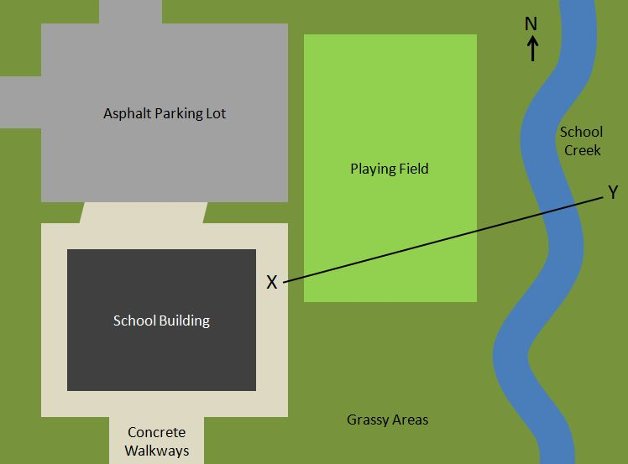
LP-Based Formative Assessments
Quick classroom assessments
Include supporting materials for teachers:
  Assessment item
  Description of purpose and target response
  Key for determining students’ levels of achievement
  Suggestions for instruction for students at each level
Notes:
Elicits student responses (#2)
Linked to WSLP (#1)
Guides teachers in analyzing student responses to determine students’ levels of achievement. (#2)
Provides instructional suggestions to support students in moving to the next level of achievement. (#2)

Slide 7
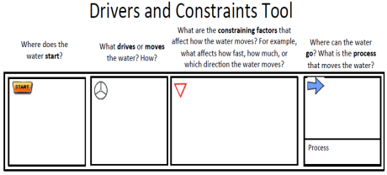

Tools for Reasoning
Intended to scaffold development of scientific accounts (hows and whys)
Address specific LP-related challenges students encounter
  Attending to driving forces and constraining factors
  Considering likelihood of multiple/diverse pathways
  Distinguishing scale and using scale in scientific accounts
Before
After
Before
After
Before
After

Slide 8
Research Questions
Does incorporation of LP-based tools into instruction impact student learning?
How do teachers’ uses of LP-based tools differ between teachers whose students made greater learning gains and teachers whose students made smaller learning gains?

Slide 9
Study Design
 | Participant Teachers | Comparison Teachers
No. of Teachers | 9 | 8
No. of Students | 249 | 213
Intervention | 4-day Workshop | None
Student Pre-Post Assessment | Yes | Yes
Classroom Observations | Field Notes | None
Teacher Interviews/ Focus Groups | Yes | None
Student Interviews | Yes | None

Slide 10
Data Analysis
Coded all student assessment responses
  IRR = XXXX
  IRT Analysis
Coded field notes and teacher interviews
  Learning goals
  Use of formative assessments
  Use of tools for reasoning
  Situation in local places
  Alignment of instruction with LP
Extreme Comparison (large vs no effect size)

Slide 11
Current Analysis
5 Levels
1
2
2.5
3
4
4 Steps
Step 1 Level 1-2
Step 2 Level 2-2.5
Step 3 Level 2.5-3
Step 4 Level3-4
Indicators of Level 2 and Level 3

Slide 12
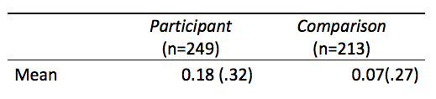
Participant Teachers and Comparison Teachers
Overall, there is a significant difference between pre-post student change (gain) for participant vs. comparison teachers (t(460)=3.91, p<.01)

Slide 13
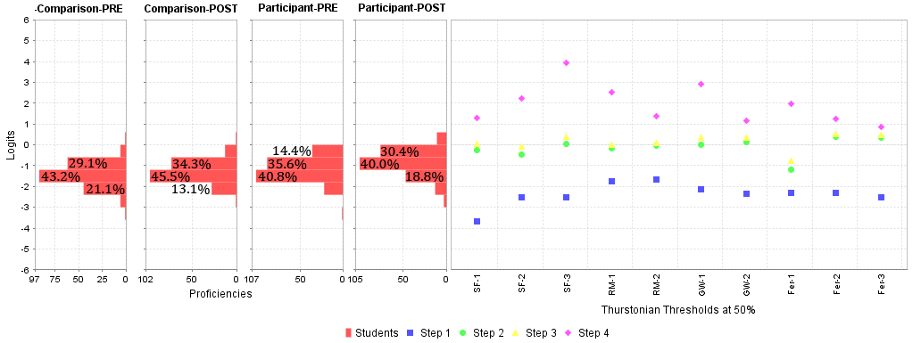
Wright Map
PRE and POST Distributions of Participant and Comparison students according to ability in the Learning Progression

Slide 14
Heat Map of Effect Size by Teacher
Label | Hedges' g
Lexi Masters | 1.23 |  | large effect
Alana Moore | 1.22 |  | medium effect
Ann Elton | 1.03 |  | small effect
Caryn Worth | 0.85 |  | no effect
Becca Thomas | 0.67
Renee Bond | 0.54
Claudio Castillo | 0.32
Jonah Booker | 0.12
Phillip Grant | 0.03

Slide 15
Large Effect Size (Ann Elton)
Learning Goals | Level 3 “Explain what makes a watershed”
Curriculum Materials | Activities from workshop
Formative Assessments | Identify class level on LP Target instruction
Tools for Reasoning | Open brainstorming; beginning press for explanation
Situation in Local Places | Situated activities in local watershed
Use of LP | Identify student level and target instruction
Alignment of instruction | School Science Stories (level 3) on the way to beginning MBR (level 4)

Slide 16
No Effect Size (Philip Grant)
Learning Goals | Level 3 “SWBAT recognize that population growth affects runoff in a watershed”
Curriculum Materials | Project Wet activities
Formative Assessments | “Anticipatory set” to hook student interest & activate prior knowledge
Tools for Reasoning | Worksheets; Level 4 language but no support for reasoning; no press for explanation
Situation in Local Places | Generic, abstract, or hypothetical watersheds
Use of LP | Grade students
Alignment of instruction | Not aligned (unproductive school science)

Slide 17
Interpretations
Both teachers teaching school science, but
  Ann = attends to student thinking; productive school science (level 3) moving towards model-based reasoning (level 4)
  Philip = performs school-required elements of instruction but no focus on student thinking; unproductive school science.

Slide 18
Conclusion
School science (level 3) instruction is a strong contextural characteristic; model-based reasoning (level 4)not-typical
More vs less-productive school science (level 3)
LP-based resources have the potential to support learning if used in ways that lead to productive uses of school science.

Slide 19
Questions
Paper available at:
http://www.umt.edu/watertools/default.aspx
Kristin Gunckel: kgunckel@email.arizona.edu
Beth Covitt: Beth.Covitt@mso.umt.edu

