Slide 1
Discussion of Experimental Set-up
Power point to accompany lesson 2 of the biodiversity teaching experiment
Written by: Jennifer Doherty, Cornelia Harris, and Laurel Hartley
Culturally relevant ecology, learning progressions and environmental literacy
Long Term Ecological Research Math Science Partnership
2012
Disclaimer: This research is supported by a grant from the National Science Foundation: Targeted Partnership: Culturally relevant ecology, learning progressions and environmental literacy (NSF-0832173). Any opinions, findings, and conclusions or recommendations expressed in this material are those of the author(s) and do not necessarily reflect the views of the National Science Foundation.

Slide 2
Lesson 2: Discussion of Experimental Set-up

Slide 3
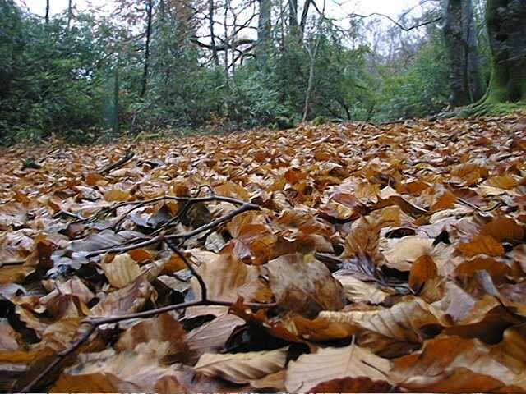
What comes from the riparian zone of the stream?

Slide 4
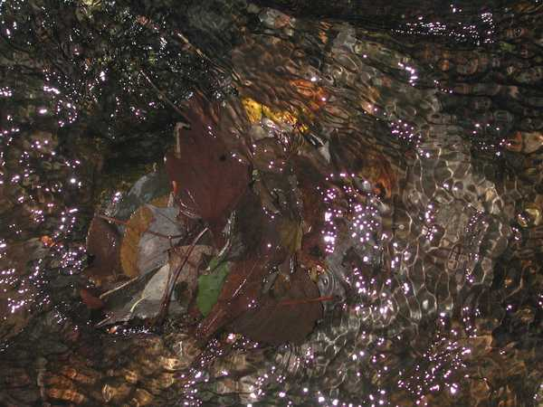
What could affect whether, and which, organisms colonize a leaf pack?
Natural leaf pack in a stream
Notes:
Hand out some leaf packs for students to observe

Slide 5
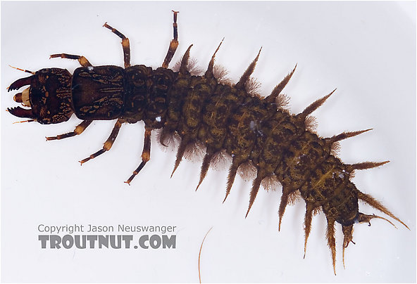
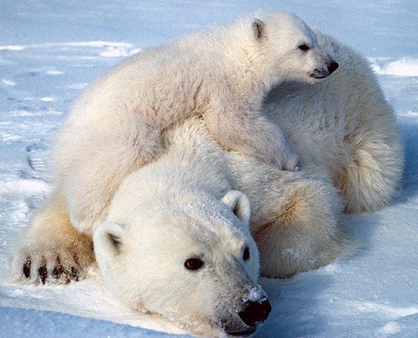
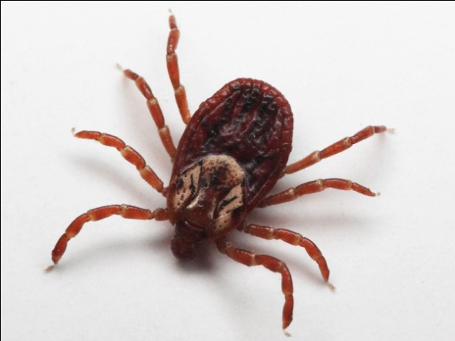
Decide whether each of these organisms could colonize a leaf pack – why would some of these organisms be more or less successful?

Slide 6
What determines whether an organism can live in an ecosystem?
Dispersal - can the organism get there?
Abiotic resources and conditions – can the organism survive the temperature, light etc?
Biotic resources and interactions - does it have food, what eats it, are there diseases?

Slide 7
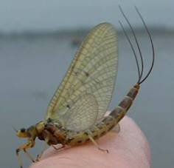
Let’s look at one organism that might live in our stream:
Mayfly larva (on left). Adult mayfly (right).

Slide 8
What would affect the survival of the mayfly?
Things that might affect dispersal of the mayfly | Abiotic factors that might be important to the mayfly | Biotic interactions that might be important to the mayfly

