Slide 1
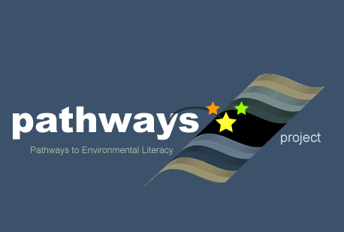

Overview: Using Learning Progressions Research to Teach for Environmental Science Literacy Presentation
Written by: Anderson, C.W (Michigan State University)
Culturally relevant ecology, learning progressions and environmental literacy
Long Term Ecological Research Math Science Partnership
April 6, 2013
Disclaimer: This research is supported by a grant from the National Science Foundation: Targeted Partnership: Culturally relevant ecology, learning progressions and environmental literacy (NSF-0832173). Any opinions, findings, and conclusions or recommendations expressed in this material are those of the author(s) and do not necessarily reflect the views of the National Science Foundation.

Slide 2
Overview: Using Learning Progressions Research to Teach for Environmental Science Literacy
Related Paper Set Presented at the Annual Meeting of the National Association for Research in Science Teaching, Rio Grande, Puerto Rico, April 6, 2013
Website: http://edr1.educ.msu.edu/EnvironmentalLit/index.htm
Notes:
Welcome to our session

Slide 3
Thanks to Funders
This research is supported in part by grants from the National Science Foundation: Learning Progression on Carbon-Transforming Processes in Socio-Ecological Systems (NSF 0815993), and Targeted Partnership: Culturally relevant ecology, learning progressions and environmental literacy (NSF-0832173), CCE: A Learning Progression-based System for Promoting Understanding of Carbon-transforming Processes (DRL 1020187), and Tools for Reasoning about Water in Socio-ecological Systems (DRL-1020176). Additional support comes from the Great Lakes Bioenergy Research Center. Any opinions, findings, and conclusions or recommendations expressed in this material are those of the author(s) and do not necessarily reflect the views of the National Science Foundation or the United States Department of Energy

Slide 4
Thanks to Contributors to this Research
Jing Chen, Li Zhan, Jonathon Schramm, Jennifer Doherty, Amy Lark, Dante Cisterna, Jenny Dauer, Jiwon Kim, Hannah Miller, Staci Sharp, Courtney Lannen, Kathryn Oleszkowicz, Etiowo Usoro, Allison Webster, Liz Thompkins, Melissa Janos, Michigan State University
Laurel Hartley, University of Colorado, Denver
Cornelia Harris, Cary Institute for Ecosystem Studies
Hui Jin, The Ohio State University
RET’s: Marcia Angle, Lawton Schools, Rebecca Drayton, Gobles Schools, Cheryl Hach, Kalamazoo Math & Science Center, Liz Ratashak, Vicksburg Schools, Debi Kilmartin, Gull Lake Schools
Mark Wilson, Karen Draney, Jinnie Choi, and HyoJeong Shin at the Berkeley Evaluation and Assessment Research Center
Notes:
I want to thank the many people who have contributed to this research, and I’m open for questions.

Slide 5
Definitions
Environmental science literacy is the capacity to understand and participate in evidence-based discussions of socio-ecological systems.
Learning progressions are descriptions of increasingly sophisticated ways of thinking about or understanding a topic
Notes:
These two basic definitions inform all of our work
I will elaborate on each

Slide 6
Defining Environmental Science Literacy: Processes in Socio-ecological Systems
Notes:
This is an important part of our definition of environmental science literacy--what we call the loop diagram.
Figure 1 on the handout
You will see strand-specific versions of the loop diagram on several of the posters.
Students need to connect human social and economic systems—the left-hand box—with environmental systems
Note that the science curriculum is in the right-hand box
We’re generally focused on the right-hand box
Environmental science literacy means understanding the right-hand box well enough to connect it with the arrows

Slide 7
Learning Progressions Include:
A learning progression framework, describing levels of achievement for students learning (Model of cognition)
Assessment tools that reveal students’ reasoning: written assessments and clinical interviews (Observation and interpretation)
Teaching tools and strategies that help students make transitions from one level to the next (Empirical validation)
Notes:
All the people doing research on learning progressions have not fully agreed on what a learning progression consists of, but here are three parts that I will talk about:
SLIDE

Slide 8
What Progresses?
Discourse: “a socially accepted association among ways of using language, of thinking, and of acting that can be used to identify oneself as a member of a socially meaningful group” (Gee, 1991, p. 3)
Practices: inquiry, accounts, citizenship
Knowledge of processes in human and environmental systems
Notes:
A core question for any learning progression is “what is the learning that progresses?”
In the past year we have settled on a 3-part answer to that question: Discourse, practices, and knowledge
I’ll talk briefly about each

Slide 9
Strands of Environmental Science Literacy
Carbon. Carbon-transforming processes in socio-ecological systems at multiple scales, including cellular and organismal metabolism, ecosystem energetics and carbon cycling, carbon sequestration, and combustion of fossil fuels.
Water. The role of water and substances carried by water in earth, living, and engineered systems, including the atmosphere, surface water and ice, ground water, human water systems, and water in living systems.
Biodiversity. The diversity of living systems, including variability among individuals in population, evolutionary changes in populations, diversity in natural ecosystems and in human systems that produce food, fiber, and wood.
Notes:
We have worked in 3 strands:
Kristin talked about water earlier this morning
My main emphasis will be on carbon.

Slide 10
Data Sources
Type of Data | Baseline Data | Pre-assessments | Post-assessments | Papers in this set
Carbon clinical interviews | 50 | 39 | 31 | 1, 2
Carbon written assessments | 725 | 464 | 1123 | 1, 3, 4
Carbon teacher assessments and videos |  | 20 | 24 | 4
Biodiversity clinical interviews | 53 |  |  | 5
Notes:
We use a variety of data sources in these presentations. The first two papers make use of clinical interviews.

Slide 11
Practices of Environmentally Literate Citizens
Discourses: Communities of practice, identities, values, funds of knowledge
Explaining and Predicting (Accounts)
What is happening in this situation?
What are the likely consequences of different courses of action?
Investigating (Inquiry)
What is the problem?
Who do I trust?
What’s the evidence?
Deciding
What will I do?
Notes:
Now our approach to practices.
Our studies of how students at different levels of sophistication make environmental decisions have led us to identify 3 key practices:
Investigating, accounts, and deciding.
Inquiry and accounts—the yellow boxes—are particularly important to us as science educators.
My planned presentation will focus mostly on accounts, but I do have a few slides on inquiry tucked away at the end if you want to discuss inquiry during the question and answer session.

Slide 12
Presentations in this Session
Inquiry learning progression framework for carbon transforming processes, by Jenny Dauer, Hannah Miller, and Charles W. Anderson

Slide 13
Practices of Environmentally Literate Citizens
Discourses: Communities of practice, identities, values, funds of knowledge
Explaining and Predicting (Accounts)
What is happening in this situation?
What are the likely consequences of different courses of action?
Investigating (Inquiry)
What is the problem?
Who do I trust?
What’s the evidence?
Deciding
What will I do?
Notes:
Now our approach to practices.
Our studies of how students at different levels of sophistication make environmental decisions have led us to identify 3 key practices:
Investigating, accounts, and deciding.
Inquiry and accounts—the yellow boxes—are particularly important to us as science educators.
My planned presentation will focus mostly on accounts, but I do have a few slides on inquiry tucked away at the end if you want to discuss inquiry during the question and answer session.

Slide 14
Contrasts between Force-dynamic and Scientific Discourse (Pinker, Talmy)
Force-dynamic discourse: Actors (e.g., animals, plants, machines) make things happen with the help of enablers that satisfy their “needs.”
  This is everyone’s “first language” that we have to master in order to speak grammatical English (or French, Spanish, Chinese, etc.)
Scientific discourse: Systems are composed of enduring entities (e.g., matter, energy) which change according to laws or principles (e.g., conservation laws)
  This is a “second language” that is powerful for analyzing the material world
We often have the illusion of communication because speakers of these languages use the same words with different meanings (e.g., energy, carbon, nutrient, etc.)
Notes:
We now say that learning science is like learning a second language.
SLIDE
I think that this is SO interesting. I have a couple of examples of interview data that I’m not going to show now, but I would be glad to share with you later.

Slide 15
Carbon Accounts: Grouping and Explaining Carbon-transforming Processes
Black: Linking processes that students at all levels can tell us about
Red: Lower anchor accounts based on informal discourse
Green: Upper anchor accounts based on scientific models
Notes:
This slide has another table from my paper.
We ask student of all ages about the linking processes in black, but what they NOTICE and interpret can be entirely different.
Students relying on informal reasoning notice that plant growth, animal growth, and animal movement all involve living things using their powers to achieve results—quite different from decay and combustion.
Scientific accounts of changes in materials focus on quite different patterns of change and therefore group the processes differently—according to how they transform carbon compounds.

Slide 16
Learning Progression Levels of Achievement for Carbon Accounts
Level 4: Coherent scientific accounts: Students successfully apply fundamental principles such as conservation of matter and energy and genetic continuity to phenomena at multiple scales in space and time (generally consistent with current national science education standards and with the draft framework for new standards).
Level 3: Incomplete or confused scientific accounts: Students show awareness of important scientific principles and of models at smaller and larger scales, but they have difficulty connecting accounts at different scales and applying principles consistently.
Level 2: Elaborated force-dynamic accounts: Students’ accounts continue to focus on actors, enablers, and natural tendencies of inanimate materials, but they add detail and complexity, especially at larger and smaller scales.
Level 1: Simple force-dynamic accounts: focus on actors, enablers, and natural tendencies of inanimate materials, using relatively short time frames and macroscopic scale phenomena.
Notes:
Our research has focused on developing detailed descriptions of these levels of achievement. Here are the descriptions in very broad terms.
SLIDE

Slide 17
Presentations in this Session
2. Alternative learning trajectories toward understanding matter and energy in socio-ecological systems. By Hannah Miller, Allison Webster, Jenny Dauer, and Charles W. Anderson

Slide 18
Data Sources
Type of Data | Baseline Data | Pre-assessments | Post-assessments | Papers in this set
Carbon clinical interviews | 50 | 39 | 31 | 1, 2
Carbon written assessments | 725 | 464 | 1123 | 1, 3, 4
Carbon teacher assessments and videos |  | 20 | 24 | 4
Biodiversity clinical interviews | 53 |  |  | 5

Slide 19
Carbon TIME Cohort 1 (2011-12) Student Learning Progression Levels

Slide 20
Year 1 Cohort Pre and Post Comparison – effect size

Slide 21
Validation of Written Assessments
Development of reliable coding rubrics: developmental and full coding, revision procedures, inter-rater reliability
Standard item statistics: difficulty, discrimination
IRT-based analyses
  Fit to model
  Step difficulties, Wright Maps
Comparison of written and interview assessments

Slide 22
Presentations in this Session
3. Designing learning progression assessments that assess principles first, by Kathryn Oleszkowicz, Jennifer H. Doherty, and Charles W. Anderson

Slide 23
Data Sources
Type of Data | Baseline Data | Pre-assessments | Post-assessments | Papers in this set
Carbon clinical interviews | 50 | 39 | 31 | 1, 2
Carbon written assessments | 725 | 464 | 1123 | 1, 3, 4
Carbon teacher assessments and videos |  | 20 | 24 | 4
Biodiversity clinical interviews | 53 |  |  | 5

Slide 24
Presentations in this Session
4. Teachers’ implementation of curriculum units and student learning in carbon-transforming processes, by Jiwon Kim, Li Zhan, and Charles W. Anderson

Slide 25
Strands of Environmental Science Literacy
Carbon. Carbon-transforming processes in socio-ecological systems at multiple scales, including cellular and organismal metabolism, ecosystem energetics and carbon cycling, carbon sequestration, and combustion of fossil fuels.
Water. The role of water and substances carried by water in earth, living, and engineered systems, including the atmosphere, surface water and ice, ground water, human water systems, and water in living systems.
Biodiversity. The diversity of living systems, including variability among individuals in population, evolutionary changes in populations, diversity in natural ecosystems and in human systems that produce food, fiber, and wood.
Notes:
We have worked in 3 strands:
Kristin talked about water earlier this morning
My main emphasis will be on carbon.

Slide 26
Data Sources
Type of Data | Baseline Data | Pre-assessments | Post-assessments | Papers in this set
Carbon clinical interviews | 50 | 39 | 31 | 1, 2
Carbon written assessments | 725 | 464 | 1123 | 1, 3, 4
Carbon teacher assessments and videos |  | 20 | 24 | 4
Biodiversity clinical interviews | 53 |  |  | 5

Slide 27
Presentations in this Session
5. Using scenario-based assessments to build a learning progression framework for reasoning about ecosystems, by Jennifer H. Doherty, Laurel M. Hartley, Cornelia Harris, John Moore, Alan Berkowitz, and Charles W. Anderson

Slide 28
Biodiversity: Grouping and Explaining Ecosystems and Subsystems
Dimensions | Subsystems Larger systems
Upper Anchor Parts | Individuals | Kinship groups | Populations | Biotic commu-nities | Ecosystems
Comparison Tasks | Kelp forest dispersal | Python families | Python range | Kelp forest food web | Python abiotic effects
Lower Anchor Parts | Individuals | Families | Relationships |  | Places or settings
Dimensions | Actors Enablers, settings
Black: Linking processes that students at all levels can tell us about
Red: Lower anchor accounts based on informal discourse
Green: Upper anchor accounts based on scientific models

Slide 29
Presentations in this Session
Inquiry learning progression framework for carbon transforming processes, by Jenny Dauer, Hannah Miller, and Charles W. Anderson
Alternative learning trajectories toward understanding matter and energy in socio-ecological systems. By Hannah Miller, Allison Webster, Jenny Dauer, and Charles W. Anderson
Designing learning progression assessments that assess principles first, by Kathryn Oleszkowicz, Jennifer H. Doherty, and Charles W. Anderson
Teachers’ implementation of curriculum units and student learning in carbon-transforming processes, by Jiwon Kim, Li Zhan, and Charles W. Anderson
Using scenario-based assessments to build a learning progression framework for reasoning about ecosystems, by Jennifer H. Doherty, Laurel M. Hartley, Cornelia Harris, John Moore, Alan Berkowitz, and Charles W. Anderson
Notes:
Here is the general plan for the session

Slide 30
Extra Slides

Slide 31
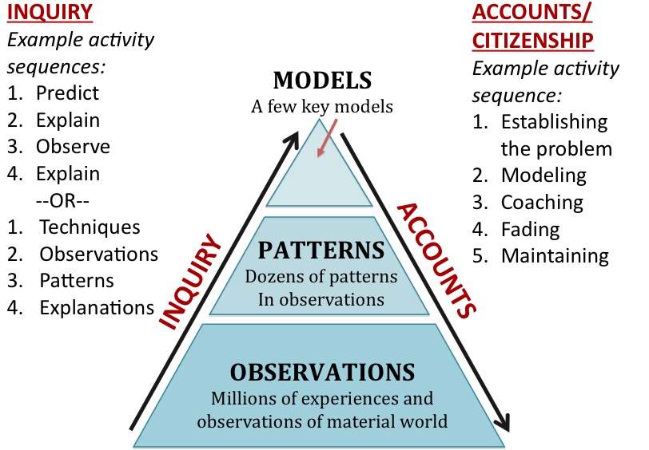
Teaching Experiments: Inquiry and Application Activity Sequences
Notes:
Here is another of those placeholder slides. In our current project we are working to engage students in inquiry and application (accounts) in ways that enable them to make transitions among levels.

Slide 32
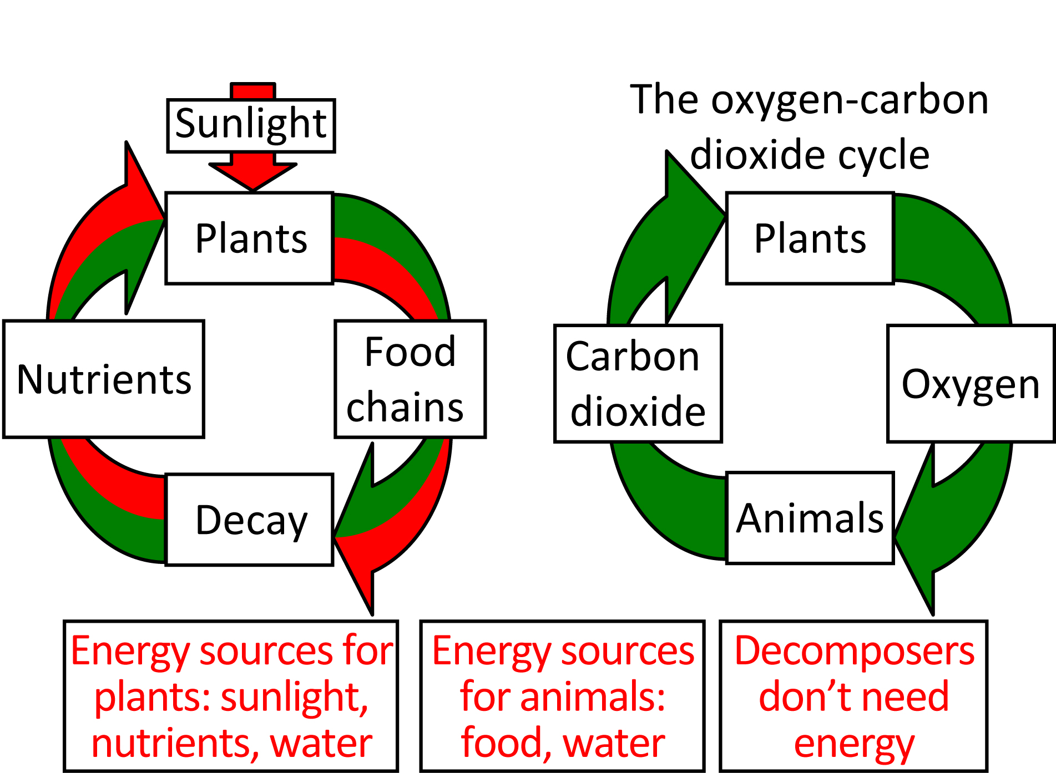
Level 3: Nutrient and O₂-CO₂ Cycles

Slide 33
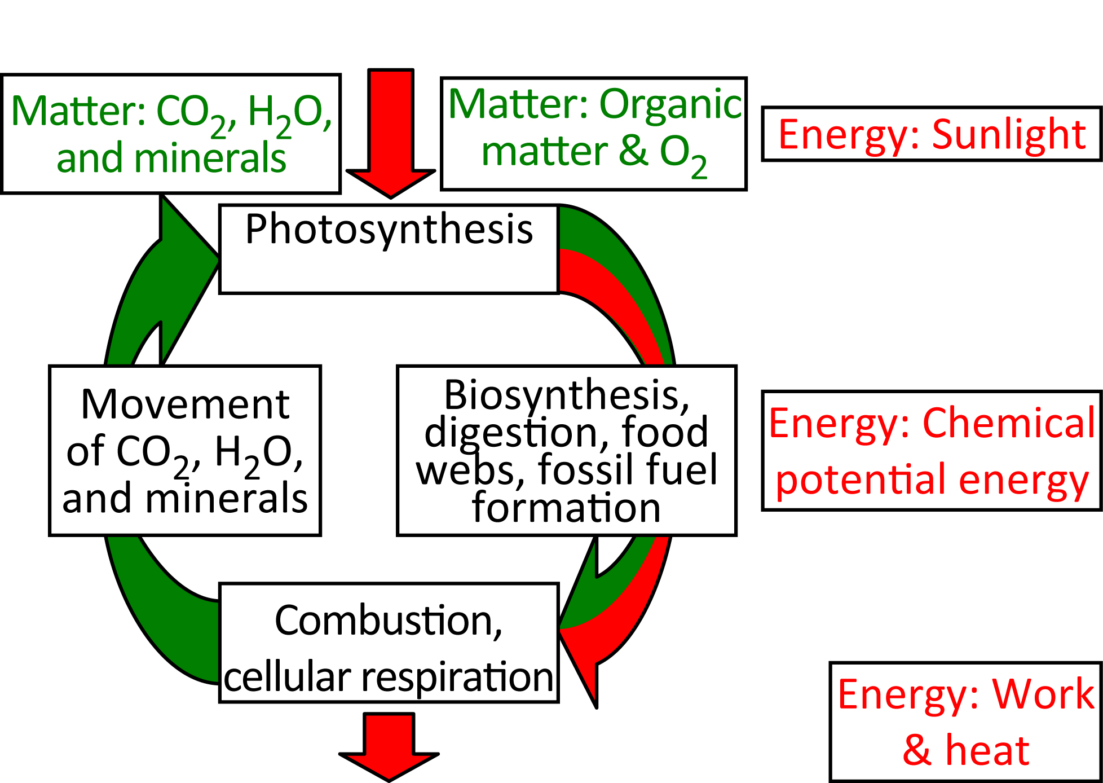
Level 4: Scientific Account Carbon Cycling and Energy Flow
Notes:
Here’s another version of the loop diagram, our Upper Anchor:
Matter cycles in Earth systems—green arrows. Note that the carbon cycle takes carbon atoms out of and back into the atmosphere.
Energy flows—red arrows. Note that energy and matter are not interconverted and are never the same.

Slide 34
Level 2 Accounts “Matter and Energy Cycles”
Sunlight
People
& animals
Carbon
Dioxide
Nutrients
People
& animals
Decay
This is really about actors and their actions.
People are the main actors, then animals, then plants
Everything else is there to meet the needs of actors
Notes:
As we have dug deeper, we have seen that underlying this perception of two cycles is a deeply different way of making sense of matter cycling.
SLIDE BULLETS

