Slide 1
Learning Progression-Based Teaching Strategies in Environmental Science:
Teachers’ Successes and Struggles in Implementation
Julie A. Bianchini, Nissa Yestness,
Katherine J. Nilsen, Jiwon Kim, LaTisha M. Hammond, Stacey Carpenter, Tobias Irish, Sylvia D. Parker, and
Alan R. Berkowitz
NARST Annual Meeting 2014

Slide 2
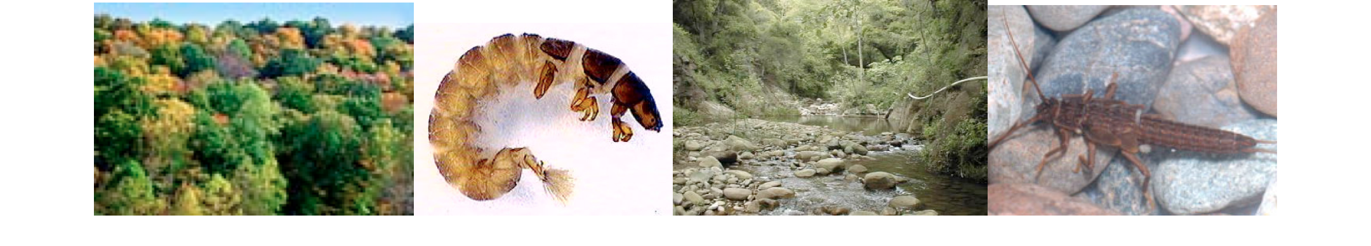
Introduction to Pathways
Pathways was a five-year environmental science research and professional development (PD) effort.
Distributed across four regions (East Coast, Great Lakes, Mountain, and West Coast).
Targeted middle school and high school science teachers.
Focused on promoting environmental science literacy through (a) developing learning progressions, (b) developing curriculum materials and assessments, and (c) supporting teachers.
Supported teachers in implementing up to 3 curricular units (Teaching Experiments, or TEs) on the Water Cycle, Carbon Cycle, and Biodiversity.

Slide 3
Pathways Research Questions
How did teacher participants make sense of learning progressions (LPs) focused on secondary students’ reasoning about biodiversity, the carbon cycle, or the water cycle?
How did the teachers make sense of LP-based teaching strategies (LPTSs) intended to elicit and build on their students’ ideas?
How did they actually implement LPTSs in their classrooms?
How did the professional development (PD) help or hinder the teachers in their understanding and implementation of LPTSs?

Slide 4
Pathways Conceptual Framework
Attending to Students’ Ideas
(Furtak, 2012; Harlow, 2010)
The Centrality of Discourse in Teaching and Learning
(Bunch, 2013; Lee, Quinn, & Valdes, 2013; Lemke, 1990)
Learning Progressions and Aligned Strategies
(NRC 2007, 2012; Jin & Anderson, 2012)

Slide 5
Pathways LP Levels
Learning Progression Levels
IV – Scientific Model-Based Accounts Students apply fundamental principles, such as conservation of energy or genetic continuity, to phenomena at multiple scales in space and time (generally consistent with current national standards).
III – School Science Accounts Students show awareness of important scientific principles and of models at smaller and larger scales, but they have difficulty connecting accounts at different scales and applying principles consistently.
II – Force-Dynamic Accounts with Hidden Mechanisms Students continue to focus on actors, enablers, and natural tendencies of inanimate materials. However, they add detail and complexity, especially at larger and smaller scales.
I – Simple Force-Dynamic Accounts Students focus on actors, enablers, and natural tendencies of inanimate materials, using relatively short time frames and macroscopic scale phenomena.
Progression of Student Learning
Notes:
Levels 1 and 2, force dynamic accounts, tend to be stories of events that focus on actors that have purposes with the help of enablers. For example, a tree’s purpose is to grow and it is aided by sunlight and water. Level 3 are descriptive accounts that tend to name processes and events and put things in order. Level 4 are model-based accounts tend to be explanatory accounts that discuss how and why and draw on principles like conservation of energy to explain how and why processes occur.

Slide 6
Pathways Teaching Strategies Aligned to Learning Progressions (LPTSs)
LPTS 1 | Big Ideas | Focus on big ideas in the field of study, supported by LP.
LPTS 2 | Planning | Plan instruction based on student understanding of topic in LP context.
LPTS 3 | Formative Assessment | Develop and use LP-based formative assessments to guide instruction.
LPTS 4 | Attending to Ideas | Carefully attend and respond to students’ thinking guided by LP.
LPTS 5 | Inquiry | Guide students in inquiry with authentic events and experiences.
LPTS 6 | Reasoning | Engage students in increasingly complex principle- and evidence-based accounts.
LPTS 7 | Local Context | Link to real problems anchored in students’ culture and place.
LPTS 8 | Citizen Practices | Support engagement in science-based citizenship decision-making practices.

Slide 7
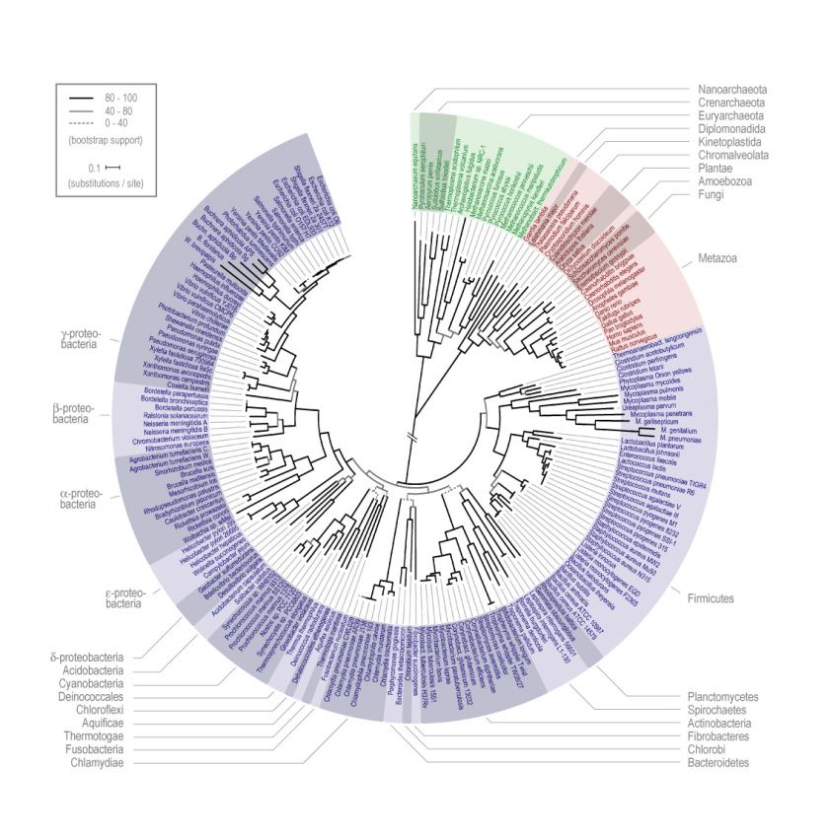
Pathways PD at Four Sites Across US
PD team included scientists, experienced teachers, science educators, postdoctoral fellows, and graduate students.
Annual summer institutes and periodic follow-up meetings during the academic year were run.
PD activities were:
  Discussed learning progressions.
  Engaged teachers in sample activities and authentic learning experiences.
  Explored students’ responses to assessments.
  Provided support during implementation.
PD teams tracked teachers’ participation in the PD and used their feedback to improve the PD and TEs.

Slide 8
Pathways Teaching Experiments
Project Themes | Teaching Experiments (TEs)
 | Biodiversity | Carbon Cycle | Water Cycle
Learning Progressions | Focus on Student Thinking | Focus on Student Thinking | Focus on Student Thinking
 | Biodiversity Assessments | Carbon Assessments | Water Assessments
Main Investigation | Leaf Pack Organisms | Plant Growth | School Campus Water Pathways
Citizenship | Evaluating socio-scientific arguments
Culture and Place | Site- and Context-Specific

Slide 9
Pathways Case Study
Teacher Participants and Topics
Region | Biodiversity TE | Carbon Cycle TE | Water Cycle TE
East Coast | 2 (HS) | 1 (HS) | 1 (HS)
Great Lakes | 2 (HS) | 1 (HS) | 1 (MS)
Mountain | 1 (MS) | 1 (MS) | 2 (MS, HS)
West Coast | 1 (MS) | 1 (MS) | 2 (MS)
HS = high school and MS = middle school
TE = Teaching Experiments (6 to 14 lesson instructional units)

Slide 10
Pathways Case Study
TARGET Teacher Participants
Teacher | Region | Grade Band | TE
Ms. P | East Coast | HS | Water Cycle
Ms. R | Great Lakes | HS | Biodiversity
Mr. J | Mountain | MS | Water Cycle
Ms. E | West Coast | MS | Carbon Cycle

Slide 11
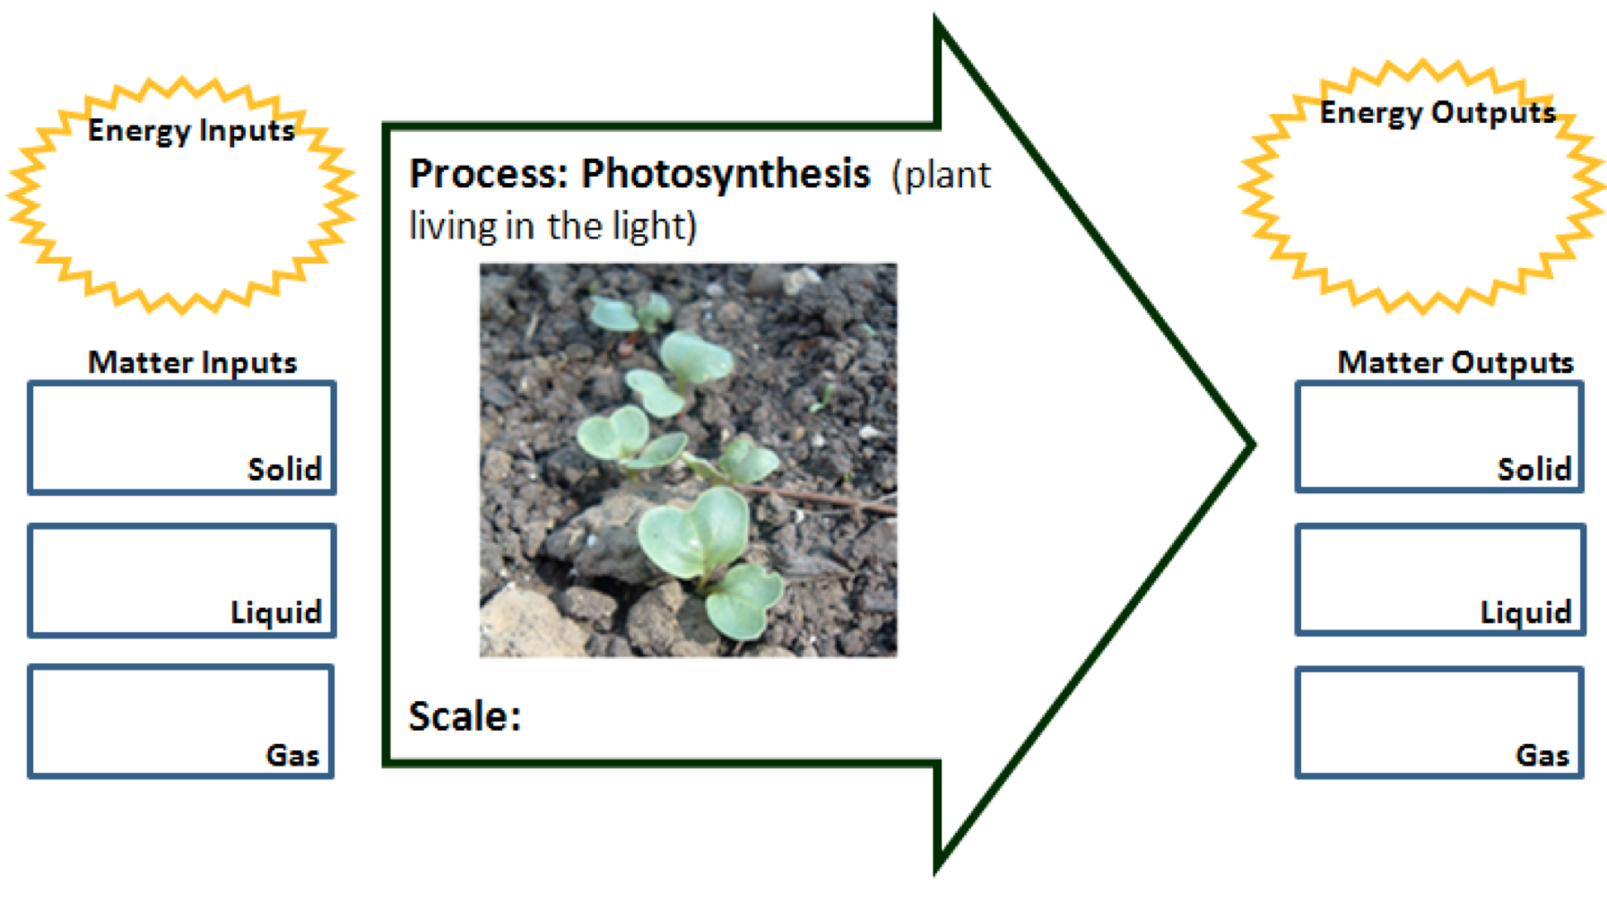
Pathways Data Collection
Data were collected during the 2012-2013 academic year.
(1) From case study teachers:
  Teacher Interviews (4 per teacher)
  Teacher Written Reflections (2 per teacher)
  Teacher Feedback Form on TE (1 per teacher)
  Teacher End-of-Year Survey (1 per teacher)
  Teacher Content Test (pre and post for TE per teacher)
  Video records of 5 lessons (1 class)
(2) From students in video recorded class:
  Student Written Work (many per student)
  Student Survey (1 per student)
  Student Focus Group (1 per class)

Slide 12
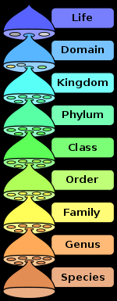
Pathways Data Analysis
To answer questions 1 (understanding of LPs),
2 (understanding of LPTSs), and 4 (views of PD support):
We examined teachers’ individual interviews, written reflections, TE feedback forms, and end-of-year surveys.
We constructed a set of a priori descriptive codes (Saldana, 2013).
(2) To answer question 3 (classroom implementation of LPTSs):
We examined video records of 5 days of classroom instruction.
We divided each lesson into segments, identified teacher-student discussions, and determined which discussions were productive (Michaels & O’Conner, 2012).
For those segments with productive discussions, we coded for LPTSs strategies used.

Slide 13
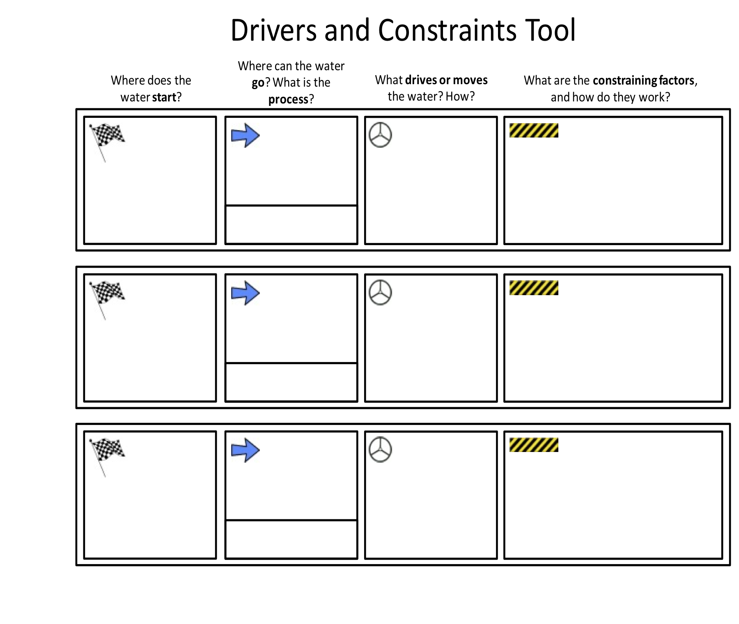
Pathways Data Analysis
Video Coding Cycle 1
Segments: Parts of a lesson delineated by topic and purpose.
For example, a teacher might introduce a process tool; the students might fill it out individually, then discuss their answers in a small group, and then share out to the rest of the class; and then the teacher connects the process tool to TE’s big idea.
Discussions: Parts of segments where a teacher interacts with one or more student.
Interaction is about content (not about attendance, discipline, etc.).
  Interaction includes at least three turns of speech.
  Ends based on teacher’s signal.
Notes:
Graphic is covering title in my version.

Slide 14

Pathways Data Analysis
Video Coding Cycle 1 (cont.)
  Productive: Describes a subset of discussions.
  Ties to TE in content and/or LPTSs.
  Includes more than asking a question and eliciting students’ ideas. A teacher asks: Why? How do you know? What does anyone else think?
  Connects/links between at least two concepts OR two dimensions of a concept.

Slide 15
Pathways Data Analysis
Video Coding Cycle 2
LPTS 1 | Big Ideas | Focus on big ideas in the field of study, supported by LP.
LPTS 2 | Planning | Plan instruction based on student understanding of topic in LP context.
LPTS 3 | Formative Assessment | Develop and use LP-based formative assessments to guide instruction.
LPTS 4 | Attending to Ideas | Carefully attend and respond to students’ thinking guided by LP.
LPTS 5 | Inquiry | Guide students in inquiry with authentic events and experiences.
LPTS 6 | Reasoning | Engage students in increasingly complex principle- and evidence-based accounts.
LPTS 7 | Local Context | Link to real problems anchored in students’ culture and place.
LPTS 8 | Citizen Practices | Support engagement in science-based citizenship decision-making practices.

Slide 16
Pathways Findings
How did the teachers make sense of learning progressions (LPs) focused on secondary students’ reasoning about biodiversity, the carbon cycle, or the water cycle?
How did the teachers make sense of LP-based teaching strategies (LPTSs) intended to elicit and build on their students’ ideas?
How did they actually implement LPTSs in their classrooms?
How did the professional development (PD) help or hinder the teachers in their understanding and implementation of LPTSs?

Slide 17
Research Findings Set 2:
LPTSs Teachers Reported Implementing
 | LPTS 1 Big Ideas | LPTS 2 Planning | LPTS 3 Formative Assessments | LPTS 4 Attending to Ideas | LPTS 5 Inquiry | LPTS 6 Reasoning | LPTS 7 Local Context | LPTS 8 Citizen Practices
Ms. P Water
Ms. R Bio-diversity
Mr. J Water
Ms. E Carbon

Slide 18
Research Findings Set 2:
LPTSs Teachers Thought Needed for Movement Along a Progression
 | LPTS 1 Big Ideas | LPTS 2 Planning | LPTS 3 Formative Assessments | LPTS 4 Attending to Ideas | LPTS 5 Inquiry | LPTS 6 Reasoning | LPTS 7 Local Context | LPTS 8 Citizen Practices
Ms. P Water
Ms. R Bio-diversity
Mr. J Water
Ms. E Carbon

Slide 19
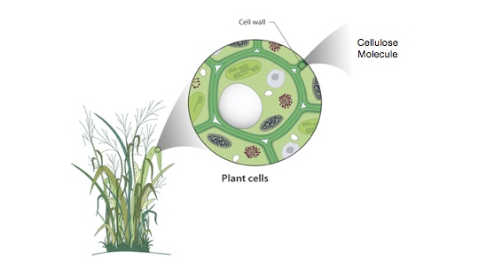
Research Findings Set 2:
LPTSs Necessary for Movement (cont.)
Mr. J argued that engagement in inquiry was more crucial for students in the lower levels of a progression (LPTS 5). He also argued that engagement in reasoning was important in moving students up higher levels of a progression (LPTS 6).
I think on the lower levels of learning progressions, students need to be engaged in the learning. They need to be doing something where they’re seeing it, experiencing it. . . . I think when you get up to the upper levels, it’s more of setting the stage for asking the question, “Why? Why? Why? Why?” And then have those students making a claim and really critiquing – challenging them to provide evidence to support that claim. I think in school we play school and you say, “Why?” “Because that’s the way th[at] nature works, because there’s heat added.” Well, then keep asking, “Why? Well, why does – what role does heat have into that? What drives that?” (Interview 1)

Slide 20
Research Findings Set 3:
Segments with Productive Discussions

Slide 21
Research Findings Set 3:
LPTSs Observed in Productive Segments

Slide 22
Pathways Discussion
Overall, we found reasonable alignment across teachers’ views of learning progressions, their views and implementation of LPTSs, and their sense of how the professional development supported their teaching.
We discuss three mismatches across views and practices here.
  LPTS 1 on Big Ideas
    Three teachers identified LPTS 1 as a key strategy to help students move along a progression and implemented them in their practice.
    However, none thought their participation in Pathways supported them in their implementation of this strategy.

Slide 23
Pathways Discussion (cont.)
We continue discussion of mismatches across views and practices.
  LPTS 2 on Planning Instruction
    Pathways researchers understand LPTS 2 as tightly tied to LPTS 3 on formative assessments and LPTS 4 on attending and responding to students’ ideas.
    However, teachers viewed only LPTS 4 as important for movement and implemented only LPTS 3 and LPTS 4 in the lessons recorded.
  LPTS 6 on Principle- and Evidence-Based Reasoning
    Three target teachers – Ms. R, Mr. J, Ms. E – thought they implemented LPTS 6 and thought it important for movement up levels.
    However, Ms. R was not recorded as implementing LPTS 6 while Ms. P was.

Slide 24
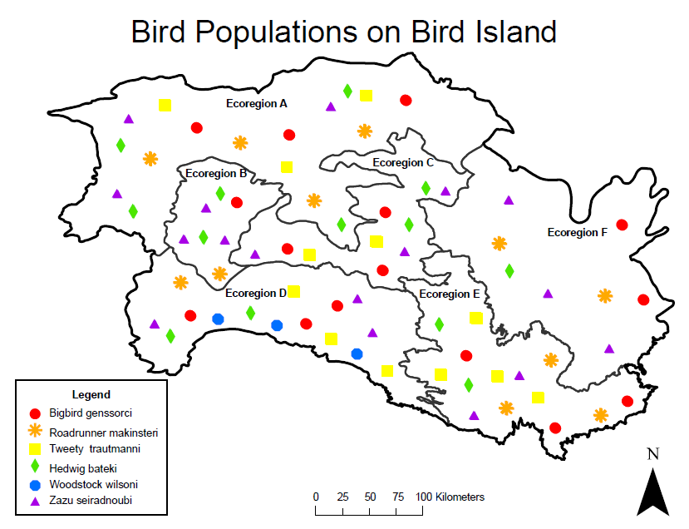
Pathways Future Directions
We have identified areas for further investigation.
Tease apart LPTS 4 on attending and responding to students’ ideas to determine (a) if and how teachers responded to and built on students’ ideas once elicited, and (b) if they tended to provide feedback more often during class rather than on written work.
Examine more closely LPTS 6 to determine if teachers engaged their students in both principle- and evidence-based reasoning or favored one type of reasoning over the other.
Compare our four target teachers to our other case study participants – to identify similarities and differences in the kinds and frequencies of LPTSs implemented.
Examine mis/matches between teachers’ implementation of LPTSs and what their students learned as a result.

Slide 25
References
Bunch, G. C. (2013). Pedagogical language knowledge: Preparing mainstream teachers for English learners in the new standards era. Review of Research in Education, 37(1), 298-341. doi:10.3102/0091732X12461772
Furtak, E. M. (2012). Linking a learning progression for natural selection to teachers' enactment of formative assessment. Journal of Research in Science Teaching, 49(9), 1181-1210. doi:10.1002/tea.21054
Harlow, D. B. (2010). Structures and improvisation for inquiry-based science instruction: A teacher's adaptation of a model of magnetism activity. Science Education, 94(1), 142–163. doi:10.1002/sce.20348
Jin, H., & Anderson, C. W. (2012). A learning progression for energy in socio-ecological systems. Journal of Research in Science Teaching, 49(9), 1149-1180. doi:10.1002/tea.21051
Lemke, J. L. (1990). Talking science: Language, learning, and values. Norwood, NJ: Ablex.
Michaels, S, & O’Connor, C. (2012). Talk science primer. Cambridge, MA: TERC.
National Research Council. (2007). Taking science to school: Learning and teaching science in grades K-8. Washington, DC: The National Academies Press.
National Research Council. (2012). A framework for K-12 science education: Practices, crosscutting concepts, and core ideas. Washington, DC: The National Academies Press.
Quinn, H., Lee, O., & Valdés, G. (2012, January). Language demands and opportunities in relation to Next Generation Science Standards for English language learners: What teachers need to know. Paper presented at the Understanding Language Conference, Stanford University, Stanford, CA.
Saldana, J. (2013). The coding manual for qualitative researchers. Los Angeles, CA: Sage.

Slide 26

Please visit the following website for the compete paper: http://www.pathwaysproject.kbs.msu.edu/?page_id=47
This work was funded by the National Science Foundation (NSF) under grant number DUE-0832173. The views expressed here are those of the authors and do not necessarily reflect those of NSF.

